Slide 1
Where Money Comes From
Notes:
This lesson is designed to help children understand the connection between having a job and earning money from that job, which will then allow them to buy the things they need and want. It introduces the idea of having a bank account, and explains two key ways for accessing the money in the bank account, namely by using a bank card in store or by withdrawing cash from a cash machine.
For this lesson, children need to have a secure knowledge of coins and notes, and an understanding that they can be exchanged for the things we want to buy in shops.

Slide 2
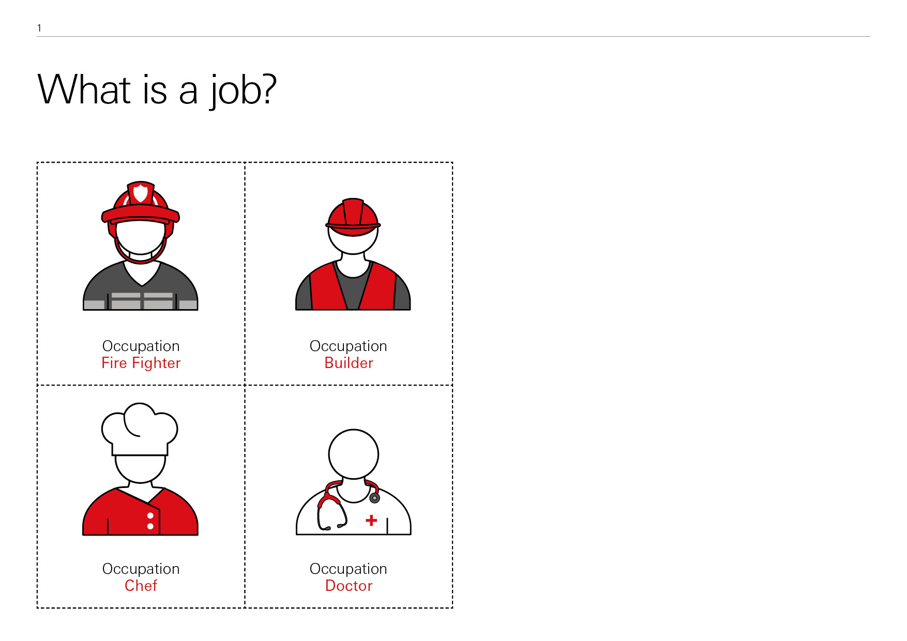
Where Money Comes From
2
Learning Objectives
To understand the important role money plays in our lives
To understand where money comes from

Slide 3
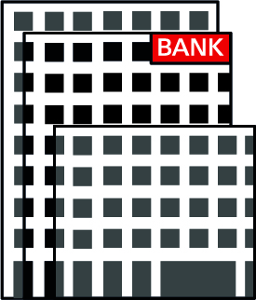
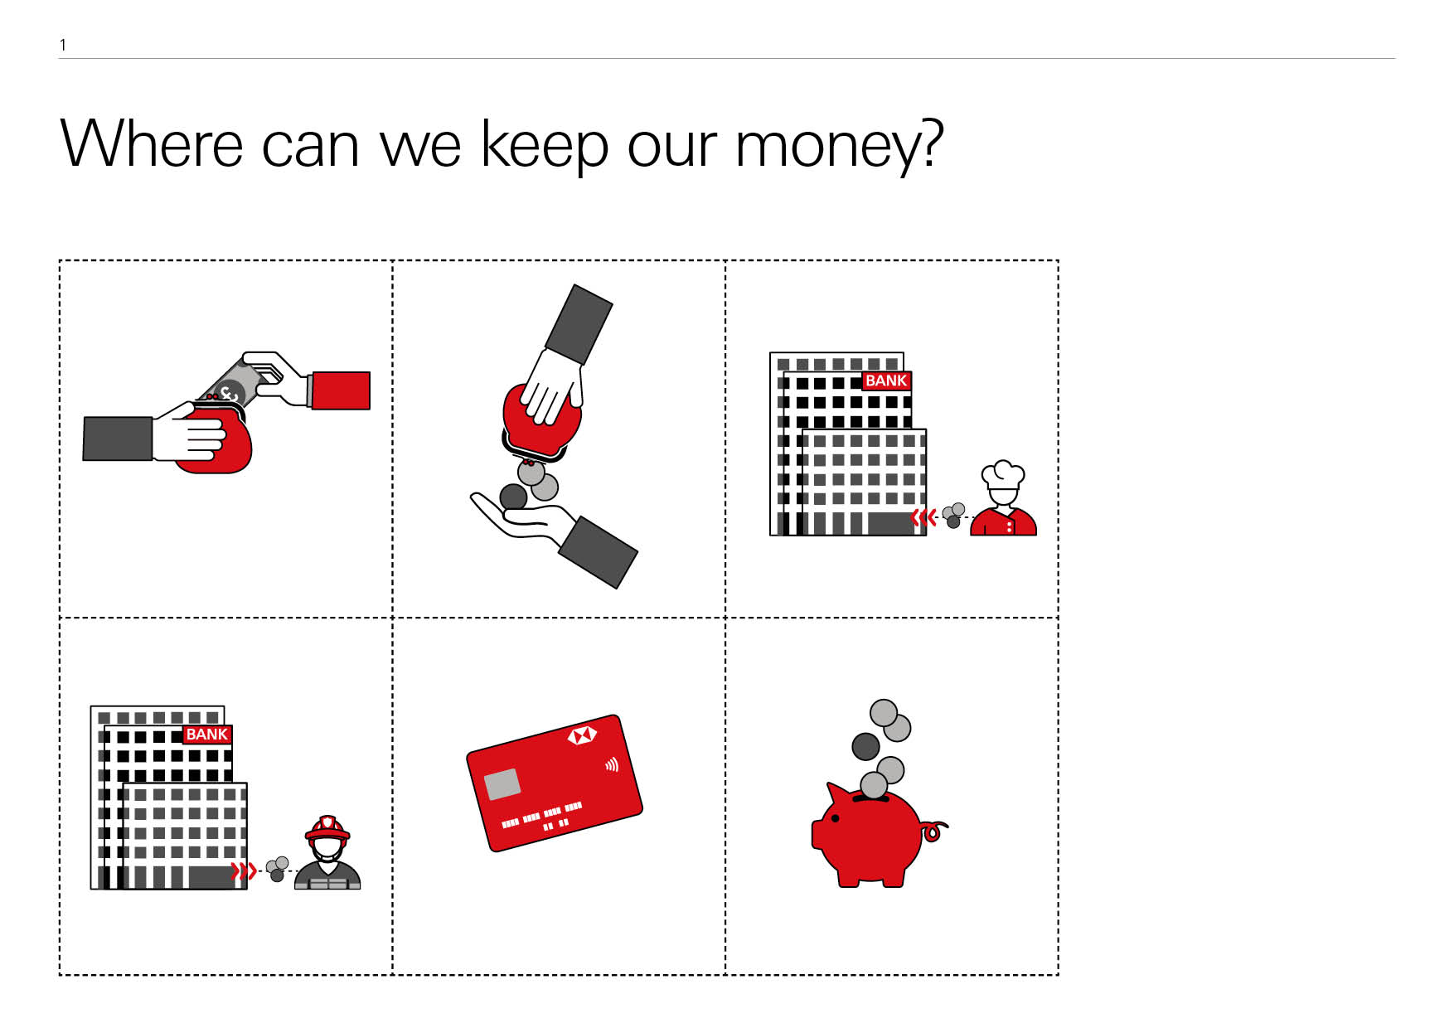

Where Money Comes From
Today we will learn…
That, in the future, we can earn money by working and being paid for the work we do
That the money we earn from working can be kept in a bank account
About some of the ways we can access the money in our bank account

Slide 4
What is a job?
Where Money Comes From
Notes:
Start the lesson by showing the children these images representing different jobs. Ask them to identify what jobs they think the people in the images do? Do they know any other kinds of jobs or work?

Slide 5
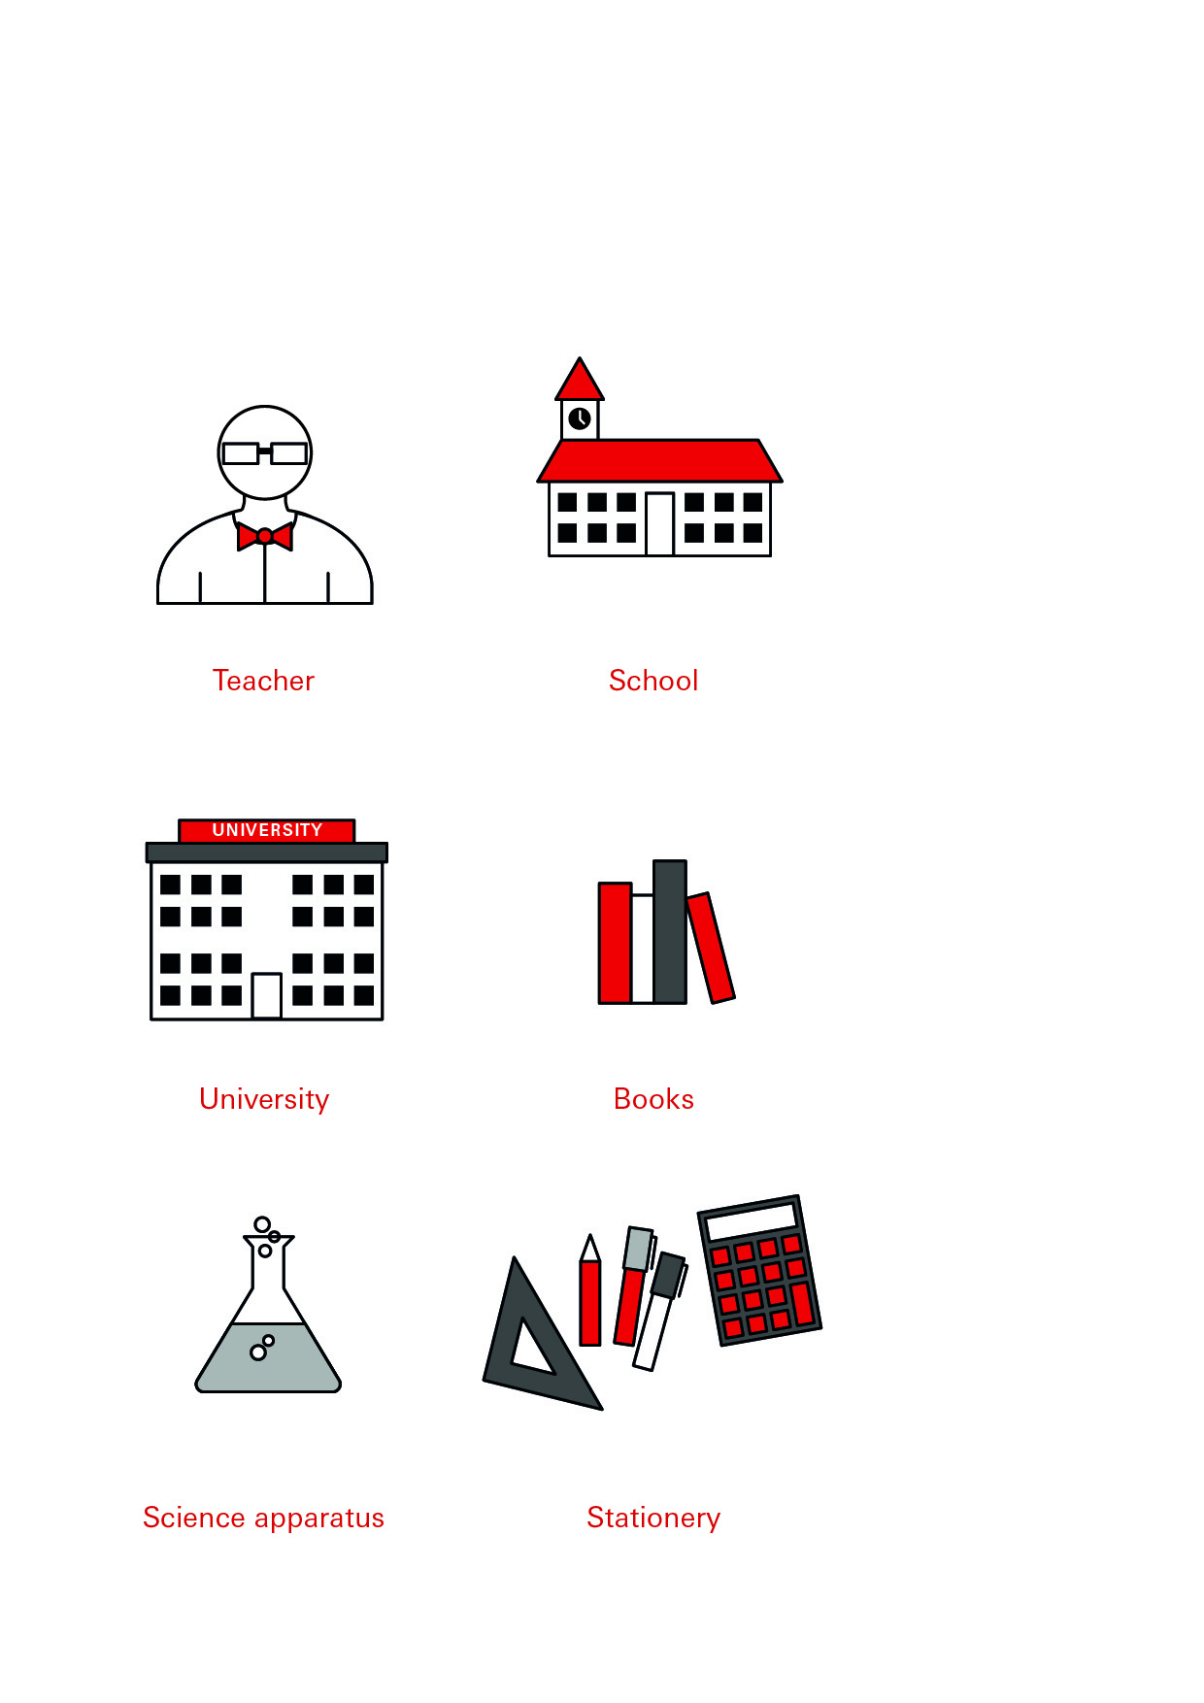
What job is this?
Where Money Comes From
Notes:
Use this slide to explain that being a teacher is your job. When you are teaching the class, you are doing your job; you are working.

Slide 6
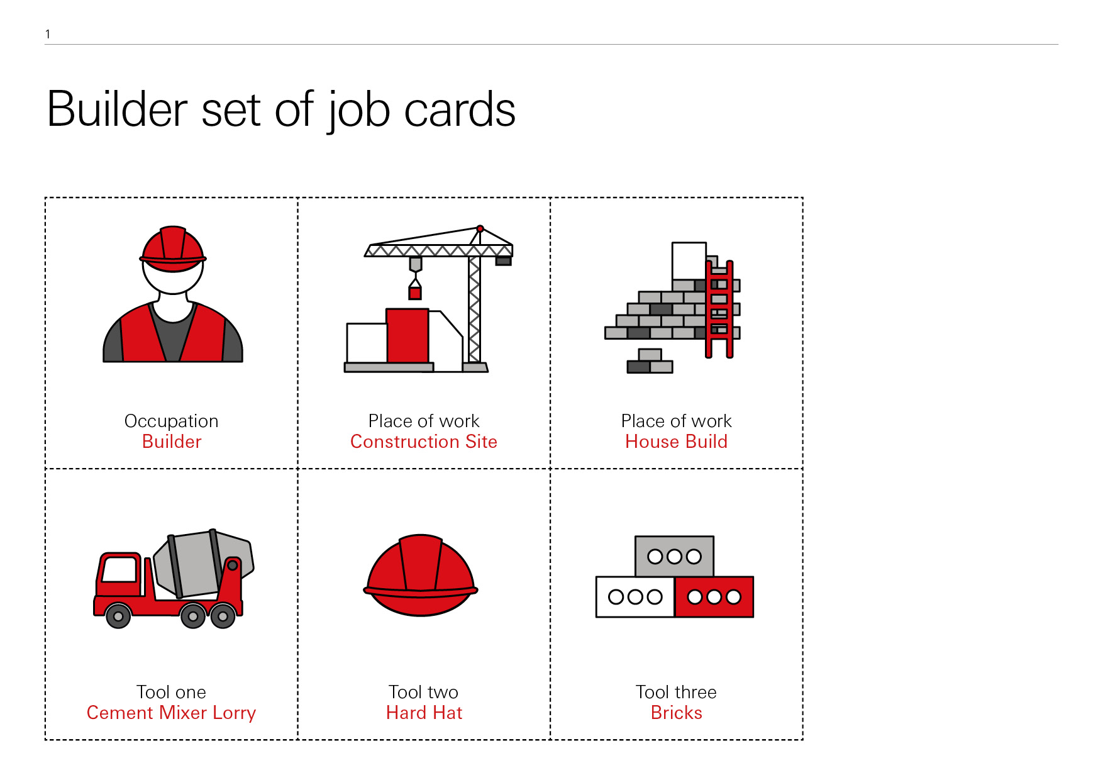
What job is this?
Where Money Comes From
Notes:
In small groups, ask the children to sort the Job cards according to each job (1 card); they need to match the person with the place they work (2 cards), and the tools and equipment they use (3 cards).
Work through the answers using the following slides showing the correct groupings.
Summarise: people do different types of jobs. When we are doing our job, we are working.

Slide 7
Where Money Comes From

Slide 8
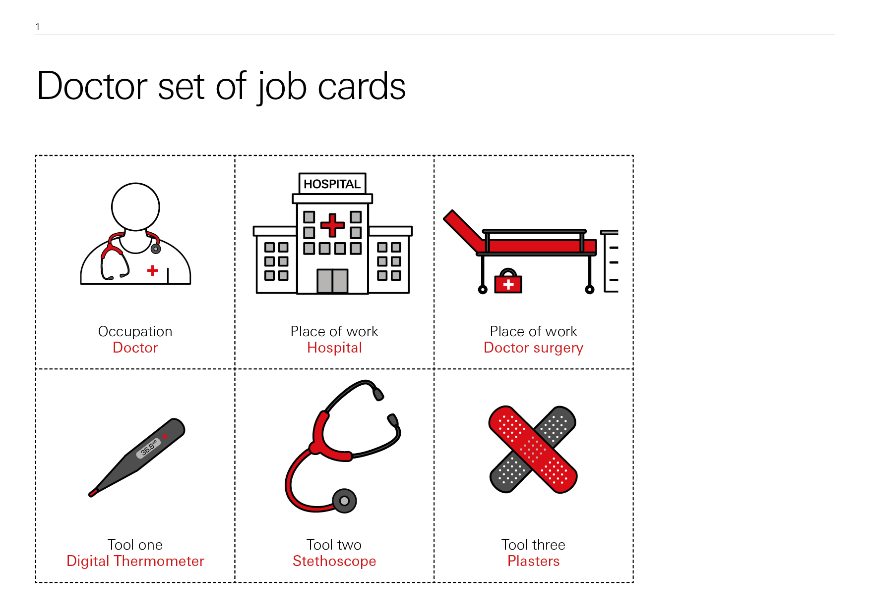

What job is this?
Where Money Comes From

Slide 9
Where Money Comes From

Slide 10
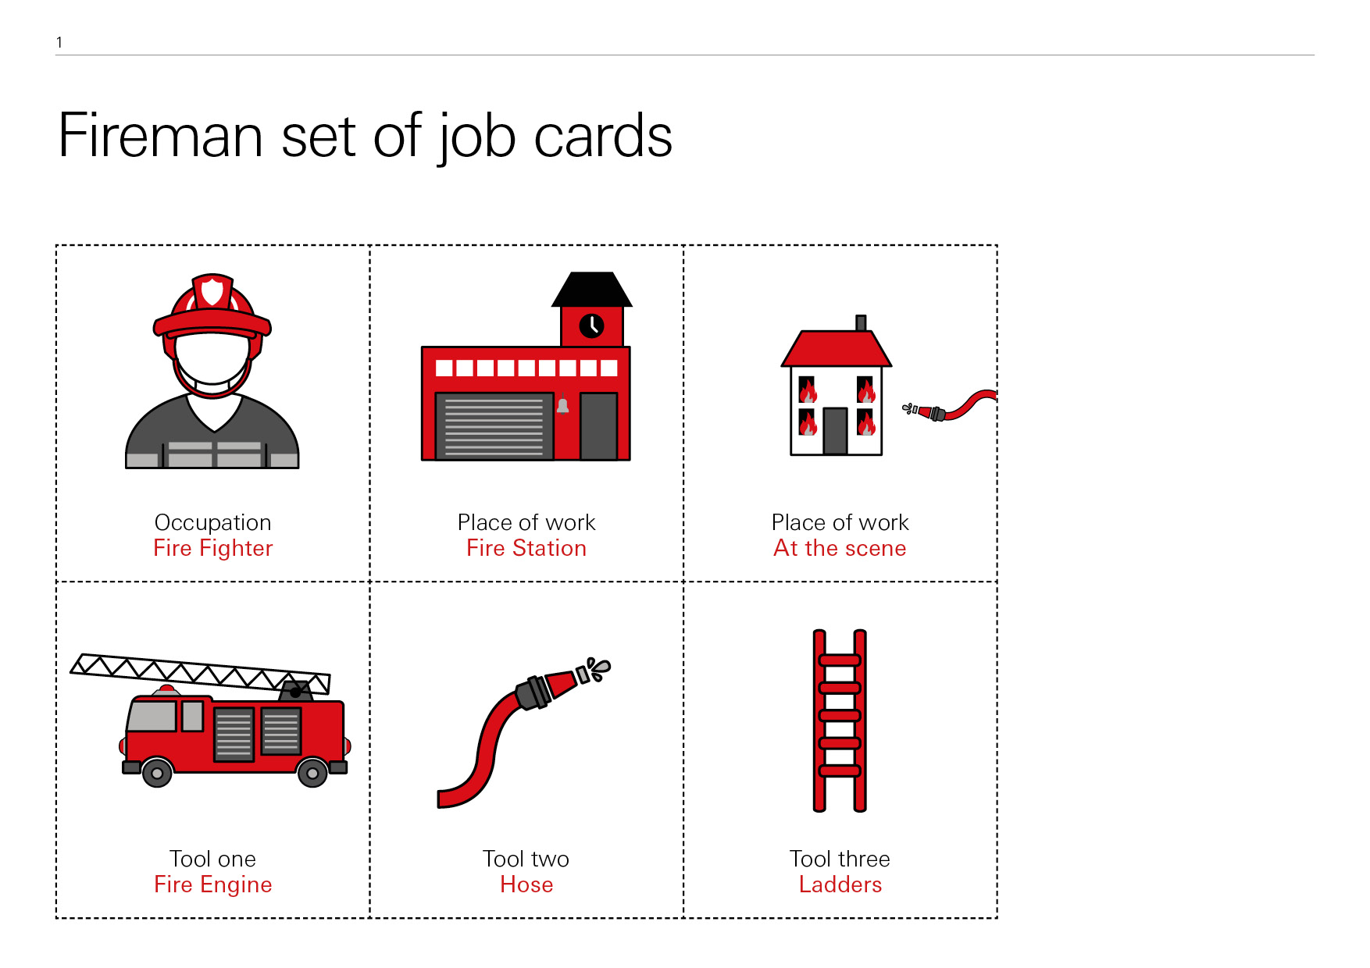
What job is this?
Where Money Comes From

Slide 11
Where Money Comes From
Firefighter

Slide 12
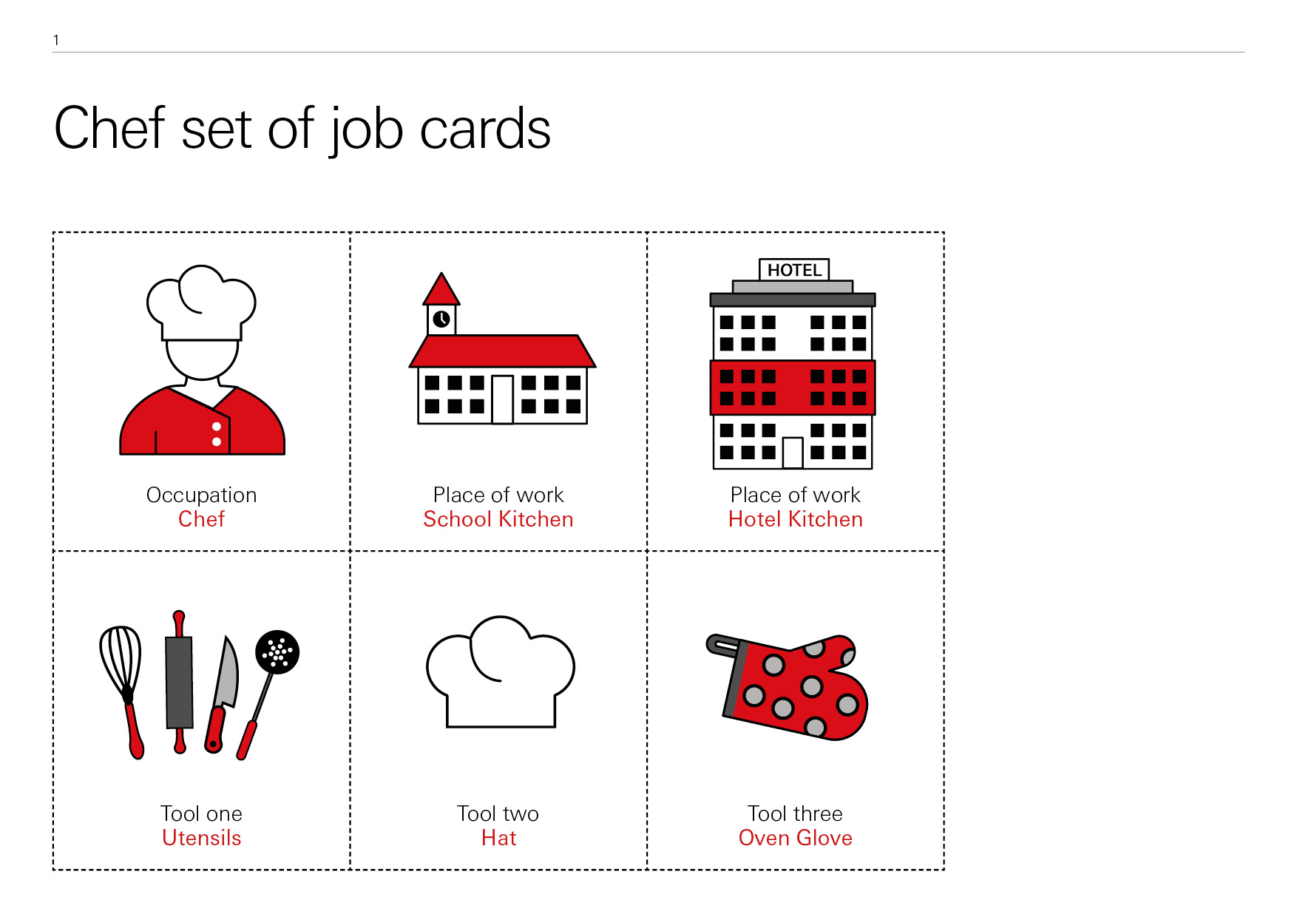
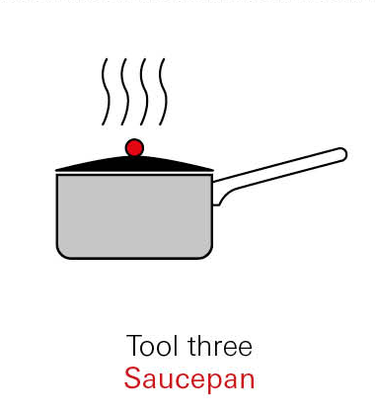
What job is this?
Where Money Comes From

Slide 13
Where Money Comes From

Slide 14
Why do people have jobs?
Where Money Comes From
Firefighter
Builder
Chef
Doctor
Notes:
1. Making the link between work and money
Ask the children why they think people have jobs? Why do they go to work?
The children might have a number of ideas. Pick up on any suggestions about money, being paid, or earning wages. Explain that if we have a job then we ‘earn’ money in return for all our hard work.

Slide 15
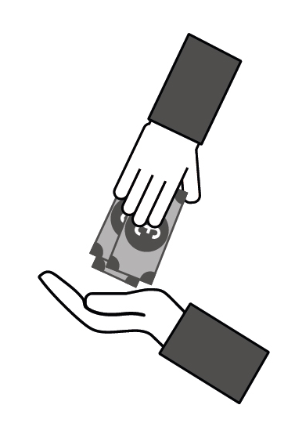
One reason why people have jobs is to earn money.
Where Money Comes From
Firefighter
Builder
Chef
Doctor
Notes:
Ask the children why they think we need money? What can we buy with money?
Again, the children may have a number of suggestions. Focus on those that involve spending money.

Slide 16
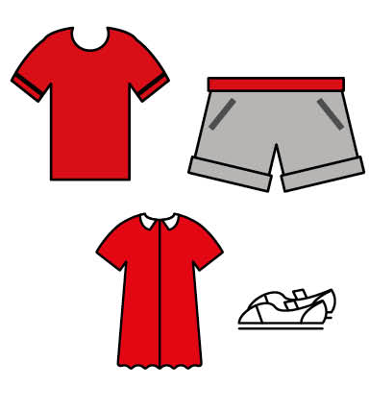

Why do we need money?
Where Money Comes From
Notes:
Use the images on this slide to talk through some different things people might spend money on. Explain that people spend the money they earn at work on all the things they, or others, need and want.

Slide 17
Where can we keep our money?
Where Money Comes From
Notes:
2. Bank accounts
Discuss all the different places the children can think of to keep money. Are some places safer than others? Where would we be most likely to keep larger amounts of money?
Pick up on any answers that refer to keeping money in a bank/bank account, or in a wallet or purse. Explain that usually we ask a bank to look after the money we earn from our job by putting it in a bank account. Using the images on this slide, make the connection between a bank account and a wallet/purse – both are places that we can put our money into and take money out of to spend.

Slide 18
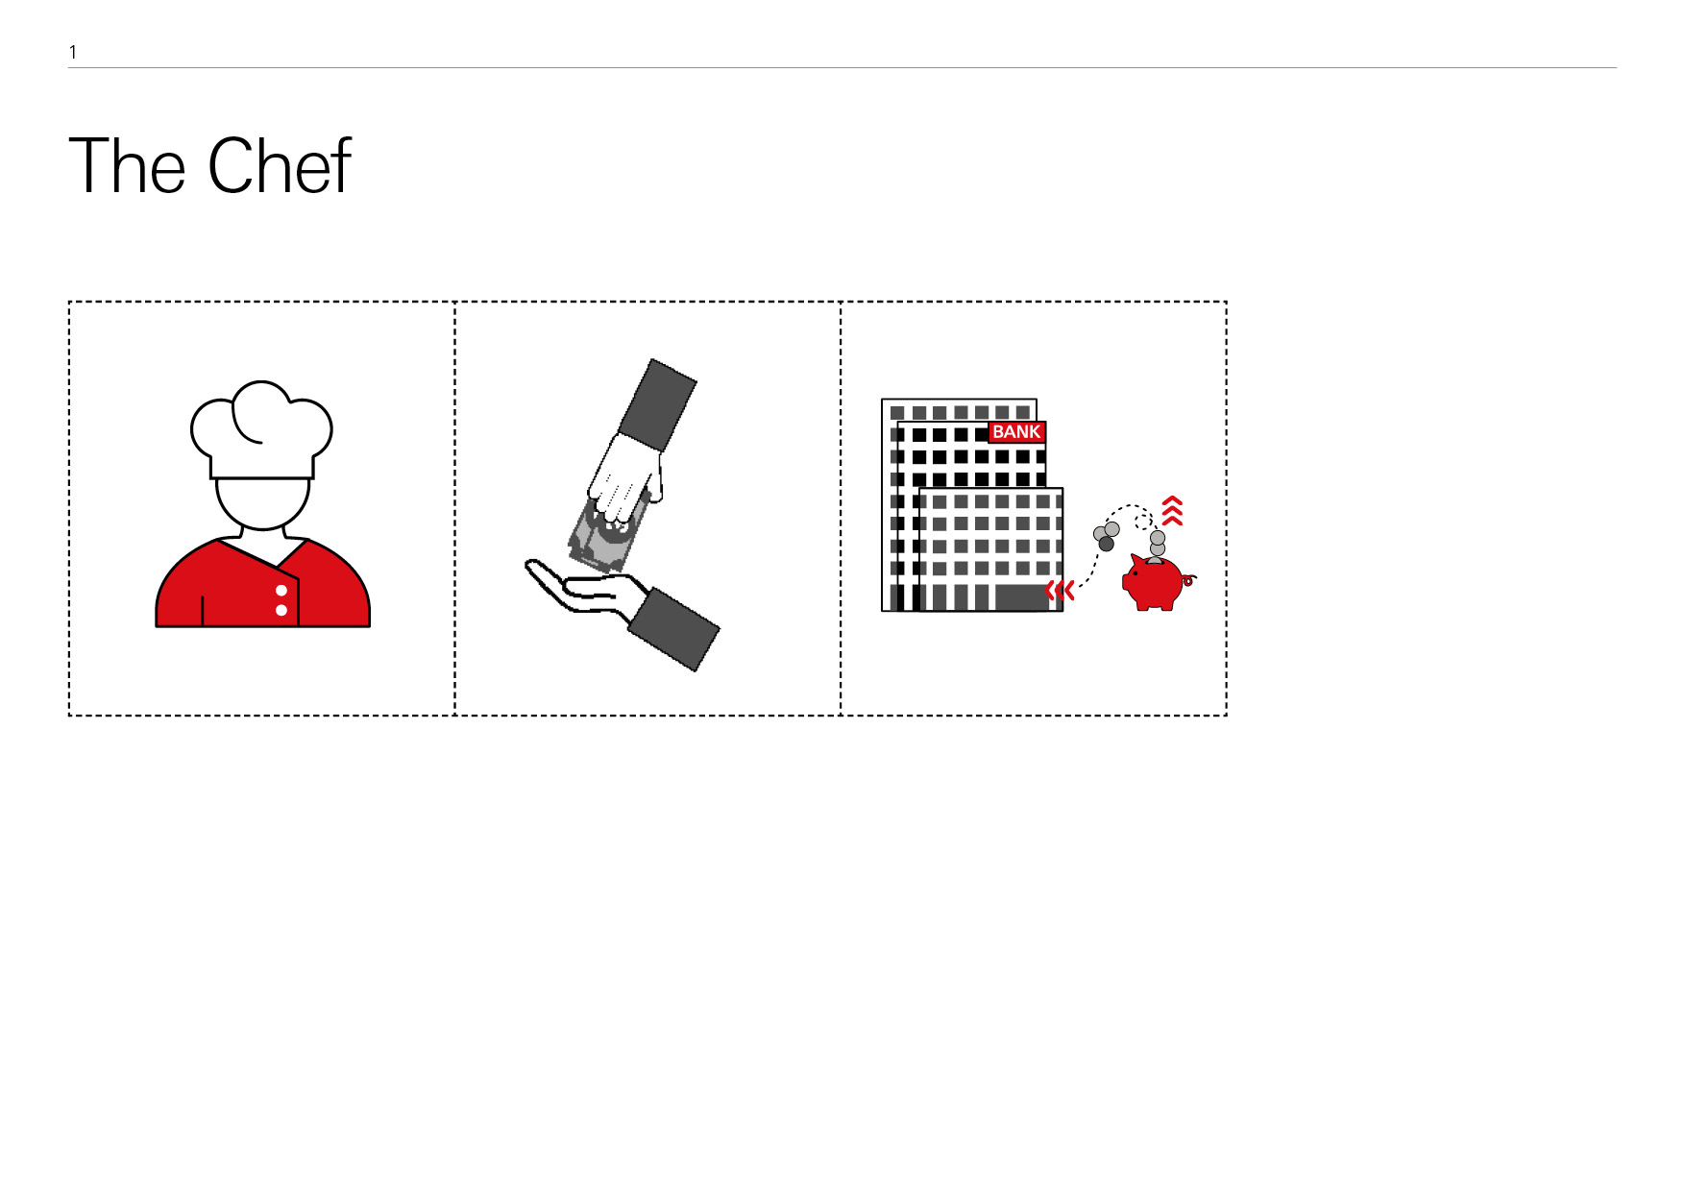
The Chef
Where Money Comes From
Notes:
Can the children explain what story the pictures are trying to convey? What is the link between them?

Slide 19
The Chef
Where Money Comes From
The Chef goes to work and does her job.
She gets paid money for all her hard work.
The money goes into her bank account.
Can you retell this story using a different job?
Notes:
After some discussion, use this slide to explain the Chef story sequence: (1) the Chef does her job; (2) she earns money in return for all her hard work; (3) the money goes into her bank account. See if they can retell the story with a different job.

Slide 20
Spending money
Where Money Comes From
How can we get our money out of our bank account to spend it?
Notes:
3. Paying by bank card
Ask the children if they know how we can get money out of our bank account?
Pick up on any answers that mention bank cards, card machines, or cash machines.

Slide 21
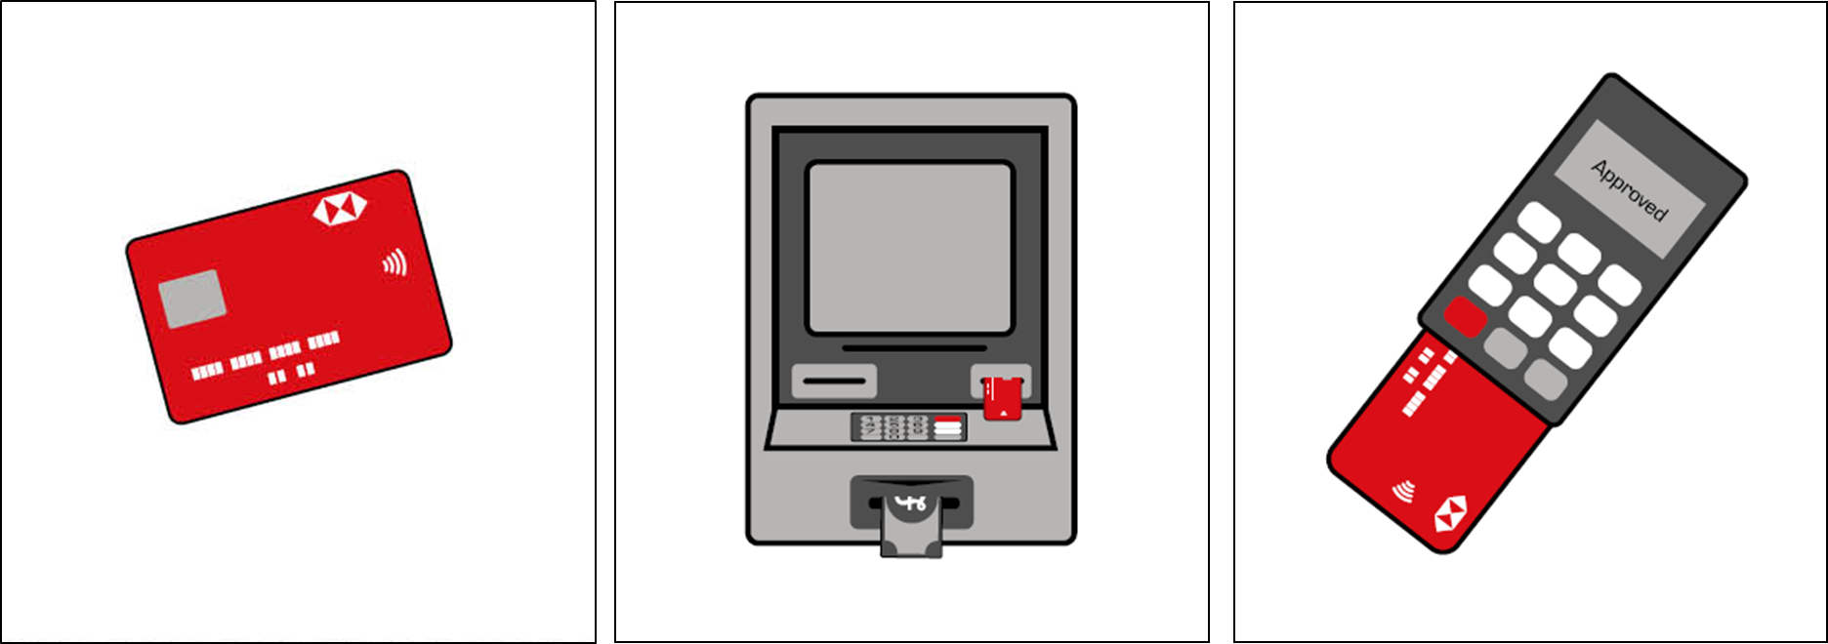
Spending money
Where Money Comes From
How can we get our money out of our bank account to spend it?
Notes:
Ask the children how a bank card can be used to pay for things in shops?
Show the image of a card machine: Has anyone seen one of these machines? Can anyone explain how to use it to pay for things in a shop?

Slide 22
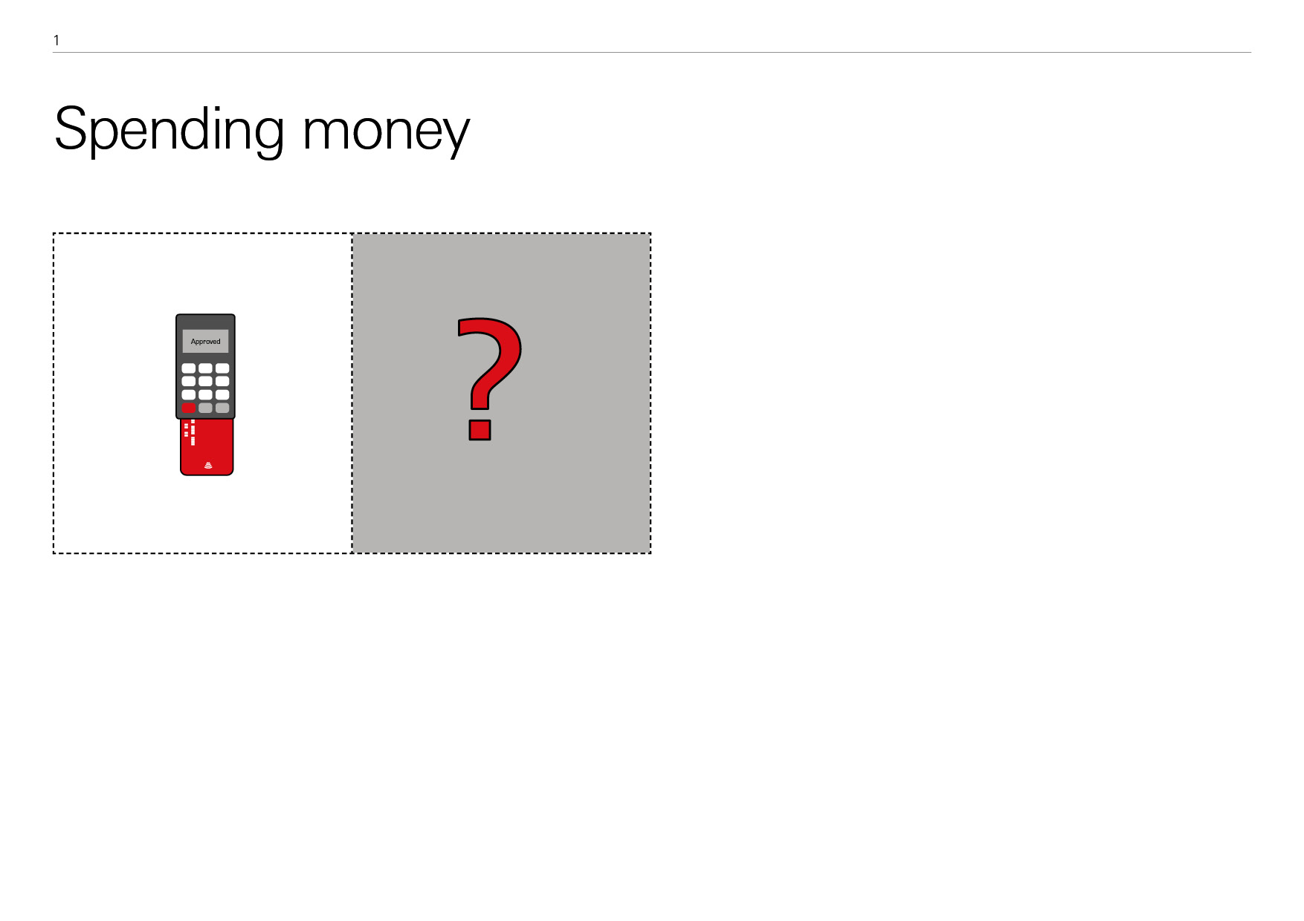
The Chef continued
Where Money Comes From
The Chef wants to use her bank card to buy some food at a shop. How can we add this to the story?
1.
2.
4.
2.
3.
5.
6.
7.
Notes:
Returning to the Chef’s story: Tell the children that the Chef wants to use her bank card to buy some food. Where in the story sequence would this happen?

Slide 23
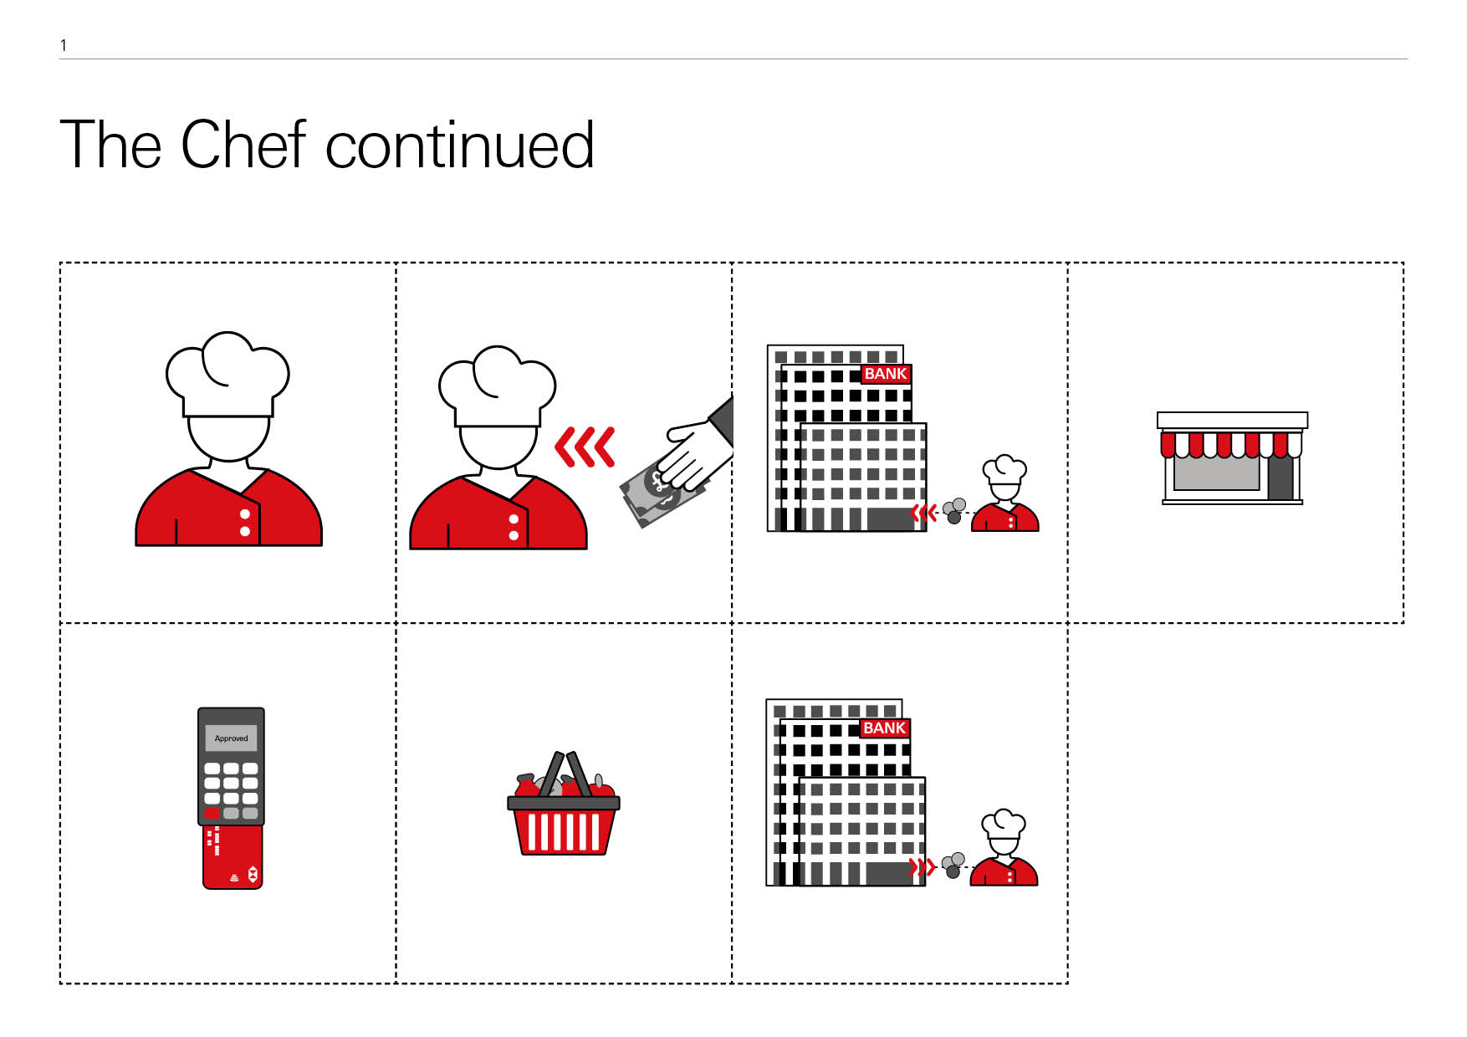
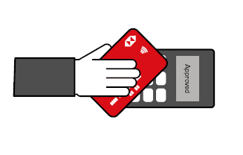
The Chef continued
Where Money Comes From
1.
2.
3.
4.
The Chef goes to work and does her job
She gets paid money for all her hard work
The money goes into her bank account
She goes to a shop
5.
6.
7.
To buy some food
She uses her bank card to pay for the food
The money is taken from her bank account
Notes:
(1) the Chef does her job; (2) she earns money in return for all her hard work; (3) the money goes into her bank account; (4) she goes to a shop; (5) to buy some food; (6) uses her bankcard to pay for the food; and (7) the money she spends is taken from her bank account.

Slide 24
Telling your own story – paying by card in a shop
Where Money Comes From
Using your cards, create your own story about someone
using their bank card to buy things in a shop.
You can use these questions to help you remember the 7 steps:
What job does your character do?
What do they get for all their hard work?
Where does the money they get paid go?
What shop do they go to?
What do they buy?
What do they use their bank card for?
Where does the money they spend come out of?
Notes:
Ask the children to use their cards to create their own story sequence choosing any of the characters from the pack. Have them use their imagination to think of different shops and things to buy.

Slide 25
Spending money
Where Money Comes From
What other way can we pay for things in a shop?
Notes:
4. Paying with cash
Ask: Do we always use a card to pay for things in shops? How else can we pay?

Slide 26
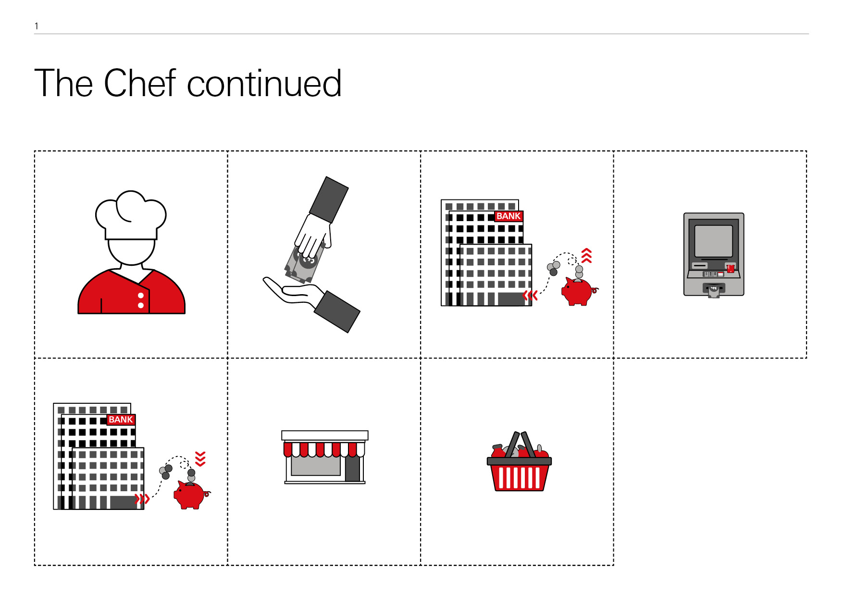
Spending money
Where Money Comes From
What other way can we pay for things in a shop?
Notes:
The children may have a number of ideas. Focus on any that include using coins and notes. Explain that cash (coins and notes) can also be used to pay for the things we need and want.

Slide 27
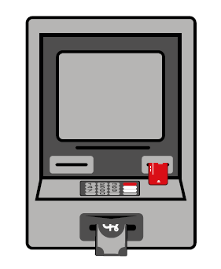
Spending cash
Where Money Comes From
How can we get cash out of our bank account to spend it?
Notes:
Show the image of a cash machine: Has anyone seen one of these machines? Can anyone explain how to use it to get money from our bank account?
Emphasise that the card you insert into the cash machine is the same bank card you put into a card reader to pay for things in a shop.

Slide 28
The Chef continued
Where Money Comes From
The Chef wants to gets some cash out of her bank account and use the cash to buy some food at a shop. Can we change the story to show this?
1.
2.
3.
4.
5.
6.
7.
8.
Notes:
Returning to the Chef’s story: Tell the children that the Chef wants to use cash to buy some food, but she needs to get the cash from her bank account first. Where in the story sequence would this happen?

Slide 29
The Chef continued
Where Money Comes From
1.
2.
3.
4.
The Chef goes to work and does her job
She gets paid money for all her hard work
The money goes into her bank account
She goes to a cash machine to withdraw cash
5.
6.
7.
8.
The money she withdraws is taken from her account
She goes to a shop
To buy some food
And pays for the food in cash
Notes:
(1) the Chef does her job; (2) she earns money in return for all her hard work; (3) the money goes into her bank account; (4) she goes to a cash machine to withdraw some cash using her bank card; (5) the money she withdraws is taken from her bank account; and (6) she goes to a shop; (7) buys some food; and (8) pays in cash.

Slide 30
Telling your own story – paying with cash in a shop
Where Money Comes From
Using your cards, create your own story about someone
using cash to buy things in a shop.
You can use these questions to help you remember the 8 steps:
What job does your character do?
What do they get for all their hard work?
Where does the money they get paid go?
How do they get cash out of the cash machine?
Where does the money that comes out of the cash machine come from?
What shop do they go to?
What do they buy?
How do they pay for what they have bought?
Now change the story again, so your character is paying with their bank card. Can you remember which story cards need to be moved or changed?
Notes:
Ask the children to use their cards to again create their own story sequence choosing any of the characters from the pack. Have them use their imagination to think of different shops and things to buy. Encourage the children to talk about who will use or enjoy the items bought.
Finally, ask the children to change their story sequence again to paying by bank card. Can they remember which cards need to be moved or replaced?

Slide 31
Plenary Option 1: Write/draw your own story
Where Money Comes From
Now it's your turn to write or draw your own story about a person who buys something in a shop using either:
Their bank card in the card machine; or
Cash that they have withdrawn from a cash machine.
When creating your story, think about these questions:
What job does the person in your story have?
What shop are they going to?
What are they going to buy?
Are they going to pay using cash or their bank card?
Notes:
Note: We have included three plenary options with this lesson to allow options if time is limited and for different age groups/abilities. If time allows, Option 1 can be combined with either of Option 2 or 3. Options 1 or 2 may also be used as home learning tasks rather than during the lesson itself. Option 3 can be used for younger or lower ability children, or if timing at the end of the lesson is limited.
Plenary Option 1: Retelling the story
Ask the children to retell one of the story sequences (paying with either cash or card) in writing or by drawing pictures. Small groups could also act out the stories with pupils taking on the roles of worker (the person with a job), the banker who keeps the money safe, the shopkeeper and the people who use or enjoy the item that has been bought.
You can use the story board templates for this – there are three different templates for the children to choose from (Green = Easiest; Amber = A little harder; Red = hardest).

Slide 32
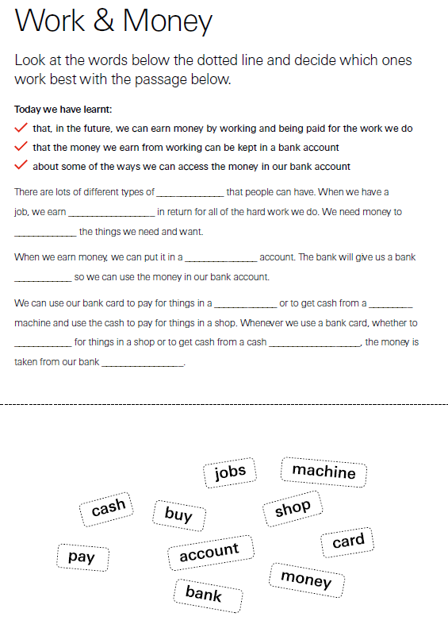
Plenary Option 2: Fill in the missing words
Where Money Comes From
Working in pairs, fill in the missing words on the worksheet to show what you have learnt today.
Notes:
Plenary Option 2: Worksheet (could also be used for home learning)
In pairs, have the children complete the Work and Money ‘missing words’ worksheet to summarise the key points from the lesson.

Slide 33
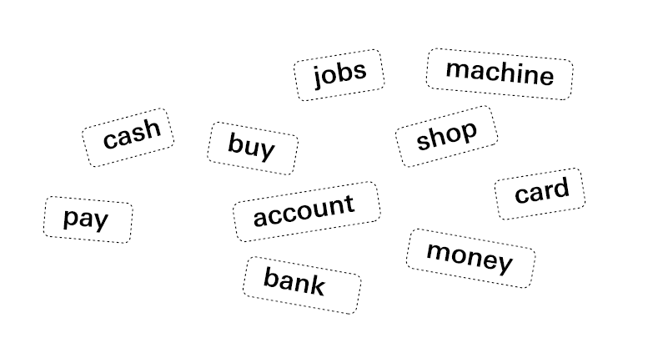
Plenary Option 3: Fill in the missing words
Where Money Comes From
There are lots of different types of ______________ that people can have. When we have a job, we earn __________________ in return for all of the hard work we do. We need money to _____________ the things we need and want.
When we earn money, we can put it in a _______________ account. The bank will give us a bank ____________ so we can use the money in our bank account.
We can use our bank card to pay for things in a _____________ or to get cash from a _________ machine and use the cash to pay for things in a shop. Whenever we use a bank card, whether to ____________ for things in a shop or to get cash from a cash ___________________, the money is taken from our bank _________________.
Notes:
Plenary Option 3: Fill in the missing words
As a class, fill in the missing would to summarise the key points from the lesson.

Slide 34
Today we have learnt…
Where Money Comes From
That, in the future, we can earn money by working and being paid for the work we do
That the money we earn from working can be kept in a bank account
That we can use the money in our bank account to pay for things using our bank card in a shop or by withdrawing cash at a cash machine

Slide 35
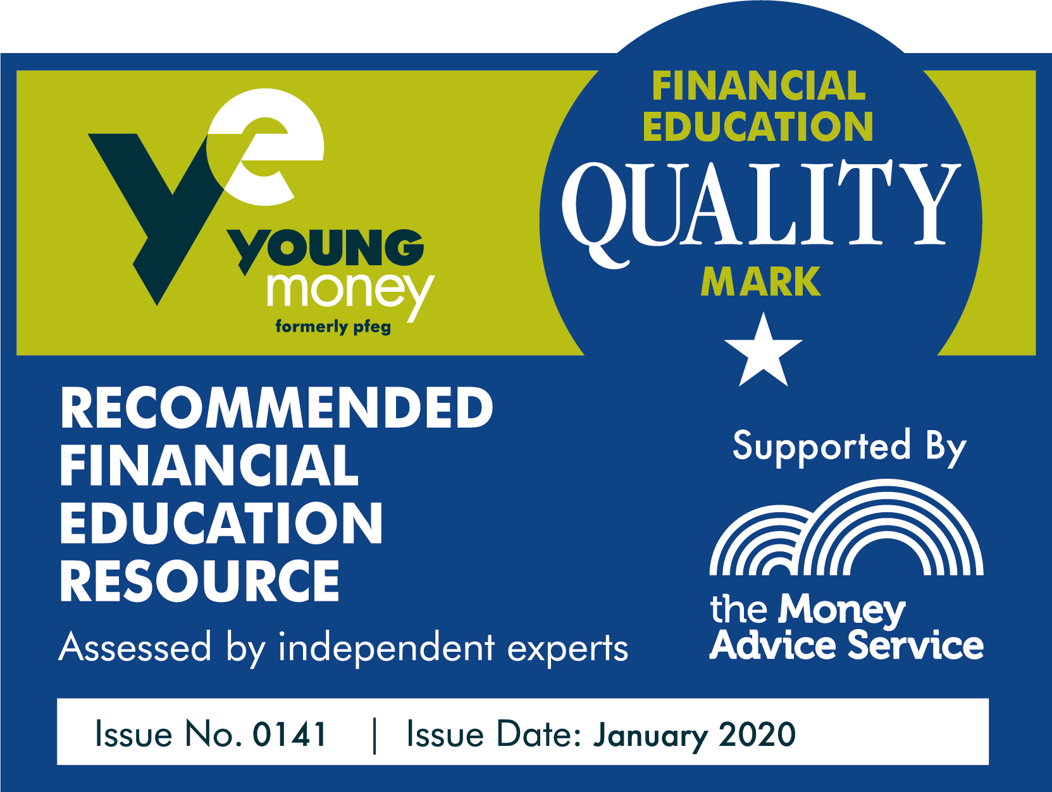
Where Money Comes From

