Slide 1
Ways to Pay
Notes:
This lesson is designed to help children understand the similarities and difference between various ‘plastic’ cards that are used to pay for things in shops. This includes using a credit card to borrow money and having to pay back more than you owe because of interest. Pupils use a ‘decision tree’ to select methods of payment and to make spending choices. They explain their decisions by giving advice to a fictional character.

Slide 2
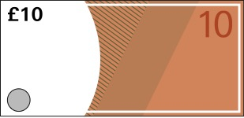
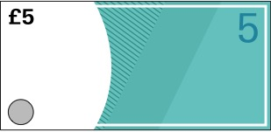
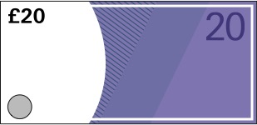

Ways to Pay
2
Learning Objectives
To understand how to manage money
To manage risk and emotions associated with money
To become critical consumers
6543 2109 8765 4321
EXP 06/22
1234 5678 9012 3456
EXP 01/22

Slide 3
Ways to Pay
Today we will learn…
About different ways we can pay for things without using cash
That a debit card is used to spend money from a bank account and a credit card is used to borrow money that has to be paid back
How to make spending choices and decide which method of payment to use
6543 2109 8765 4321
1234 5678 9012 3456
EXP 06/22
EXP 01/22

Slide 4
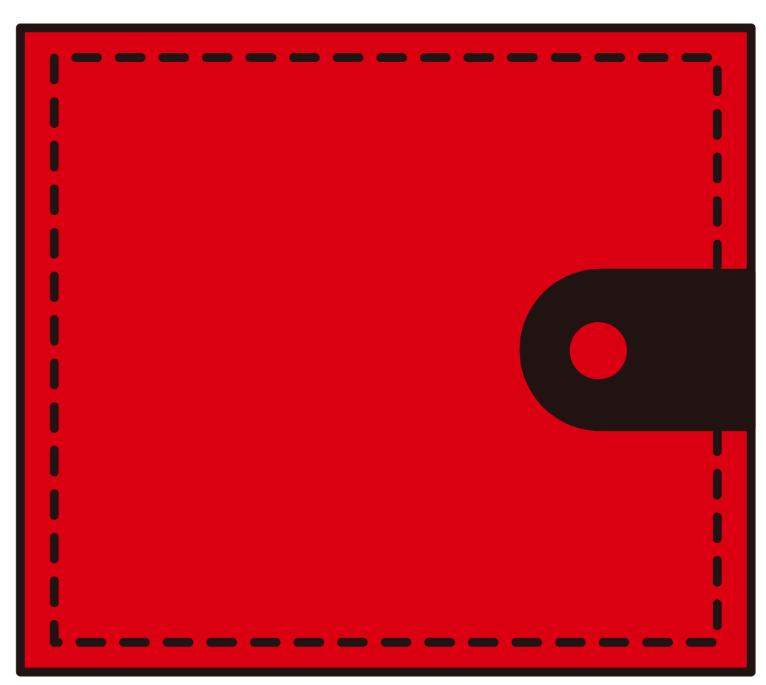
A wallet has been found in the school grounds…
Ways to Pay
What could this wallet have in it?
How can we find out who it belongs to?
How may the owner feel when they realise they have lost it?
Notes:
Start the lesson by explaining that a wallet has been found on the school grounds. You can use the slides to show pupils the contents of the lost wallet, or you could use a real wallet containing the following: a UK driving licence, a debit card, a credit card, and a gift card.
Ask the children who they think it might belong to? What do purses and wallets contain? How might the owner feel when they realise they have lost it?

Slide 5
Who does the wallet belong to?
Ways to Pay
6543 2109 8765 4321
EXP 06/22
1234 5678 9012 3456
EXP 01/22
Notes:
Explain that the contents of the wallet can provide clues about who it belongs to. Using the images of the wallet’s contents on this slide, ask the children to identify each of the items, and see if they can work out who the wallet might belong to. Can they identify all four of the different ways to pay for things included in the wallet?

Slide 6
Ways to pay
Ways to Pay
6543 2109 8765 4321
1234 5678 9012 3456
EXP 06/22
EXP 01/22
Notes:
Payment Cards – similarities and differences
Show the images of the three different cards from the wallet. Ask the children to point out the similarities and spot any differences. Acknowledge that they are all the same size and shape, and contain numbers, letters and images or symbols.
Point out: the names of the cards (debit, credit, gift); Mr Spendalot’s (the cardholder’s) name on the debit and credit card; the absence of Mr Spendalot’s name on the gift card; the value of the gift card.
Ask the children why we sometimes pay using a card instead of cash. Discuss the dangers of having a lot of cash in our pockets or wallet. If the wallet isn’t returned to Mr Spendalot he will have lost all the cash it contains. How might he feel? What if it was £100? £500? Or £1000? How would the children feel if it was their cash?

Slide 7
Paying by card
Ways to Pay
Notes:
Explain that payment cards are a way of having money in your wallet that isn’t ‘cash’; they contain ‘electronic’ or ‘digital’ money. Ask the children if they have ever seen one being used. Where can a card be used? How is it used? Using the images on this slide, point out the card reader and keypad. Acknowledge that all three cards work in a similar way but there are some very important differences.
Use the images on the next three slides to explain the functions of each card in turn. Allow the children time to note down the key features of each card before moving on to the next card. You can print copies of the Payment Card Definitions for the children to refer to throughout the rest of the lesson.

Slide 8
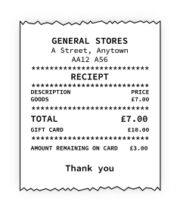
Gift card
Ways to Pay
Gift cards contain ‘electronic’ cash that you can spend at certain stores. They are called gift cards because they are often given to people as presents. They work in the same way as using cash.
If you have a £10 gift card, and use it to buy something for £7, your £3 change will stay on the card for you to spend later.
Notes:
Use the images to explain the functions of each card in turn. Allow the children time to note down the key features of each card before moving on to the next card. You can print copies of the Payment Card Definitions for the children to refer to throughout the rest of the lesson.

Slide 9
Debit card
Ways to Pay
Debit cards are used to spend money from your bank account. When you buy something using a debit card the money is taken out of your bank account and paid into the store’s bank account.
If you have £50 in your bank account, and use your debit card to buy something for £7, the amount of money in your bank account will go down by £7 to £43.
6543 2109 8765 4321
EXP 06/22
Notes:
Use the images to explain the functions of each card in turn. Allow the children time to note down the key features of each card before moving on to the next card. You can print copies of the Payment Card Definitions for the children to refer to throughout the rest of the lesson.

Slide 10
Ways to Pay
Credit card
Credit cards are used to borrow money from the bank. You have to pay back the money that you borrow plus a bit more; the ‘more’ is called ‘interest’. The bank pays the money you have borrowed into the store’s bank account (like a debit card). The longer you take to pay it back, the more interest you have to pay.
If you use a credit card to buy something for £10, you will owe the bank £10 plus a little more in ‘interest’ (an extra £1 in this example).
1234 5678 9012 3456
EXP 01/22
Notes:
Use the images to explain the functions of each card in turn. Allow the children time to note down the key features of each card before moving on to the next card. You can print copies of the Payment Card Definitions for the children to refer to throughout the rest of the lesson.

Slide 11

What am I?
Ways to Pay
You use me to spend money from your bank account.
What am I?
Notes:
Who am I? (Understanding check point)
Ask the children to turn their Payment Card Definitions over so they cannot be seen. Then challenge the children to a quick game of What am I? to check they understand the key differences between the three cards.

Slide 12
What am I?
Ways to Pay
You use me to spend money from your bank account.
What am I?
I am a debit card.
6543 2109 8765 4321
EXP 06/22

Slide 13
What am I?
Ways to Pay
If you use me to buy something you will owe money to the bank.
What am I?

Slide 14
What am I?
Ways to Pay
If you use me to buy something you will owe money to the bank.
What am I?
I am a credit card.
1234 5678 9012 3456
EXP 01/22

Slide 15
What am I?
Ways to Pay
You can use me like cash to buy things in a store, and your change stays on the card.
What am I?

Slide 16
What am I?
Ways to Pay
You can use me like cash to buy things in a store, and your change stays on the card.
What am I?
I am a gift card.

Slide 17
What am I?
Ways to Pay
I am extra money you have to pay to the bank if you buy something using a credit card.
What am I?

Slide 18
What am I?
Ways to Pay
I am extra money you have to pay to the bank if you buy something using a credit card.
What am I?
I am interest.
+

Slide 19

Spending Scenario 1
Mum’s birthday
Ways to Pay
Mrs Thrifty wants to buy her Mum some flowers for her birthday. She only has a £10 note in her purse. She finds a bunch of roses that cost £10.
How much does it cost?
Has she got enough money?
Does she need the item?
How will she pay?
Consequences?
Notes:
The Decision Tree
Acknowledge that the owner of the purse has a lot of payment options: cash; gift card; debit card; and credit card. Give pairs or small groups a copy of The Decision Tree and ask them to turn their Payment Card Definitions face up so they can be seen. Ask the children to follow the branches of the Decision Tree as you present the spending scenarios. Use the following discussion points to help the children consider the characters’ choices and the potential consequences:
Spending Scenario 1: Mum’s birthday: acknowledge this is fairly straightforward as Mrs Thrifty only has one way of paying.

Slide 20

Spending Scenario 2
Paddling pool
Ways to Pay
It’s a very hot summer. Mr Spendalot wants to buy something that will help him cool off. He goes shopping with a £20 gift card and his debit card (he has £30 in his bank account). He finds a paddling pool that costs £10.
How much does it cost?
Has he got enough money?
Does he need the item?
How will he pay?
Consequences?
Notes:
Spending Scenario 2: Paddling pool: Mr Spendalot can use either payment method but it would be wise to use the gift card as it can only be used to make purchases in that store; debit cards can be used in most shops.

Slide 21

Spending Scenario 3
Bus ticket
Ways to Pay
Mrs Thrifty’s car has broken down. It will take the garage a week to fix. Buying a weekly bus ticket to get to work will cost £5. She doesn’t have any cash, gift cards or money in her bank account.
How much does it cost?
Has she got enough money?
Does she need the item?
How will she pay?
Consequences?
Notes:
Spending Scenario 3: Bus ticket: Mrs Thrifty won’t earn any money if she can’t get to work. She can’t use her car so she must find another way. Perhaps she could get a lift from a friend at work? If not, she will have to borrow the money for the bus ticket. She must be prepared to pay back what she has borrowed plus the interest the bank will charge.

Slide 22
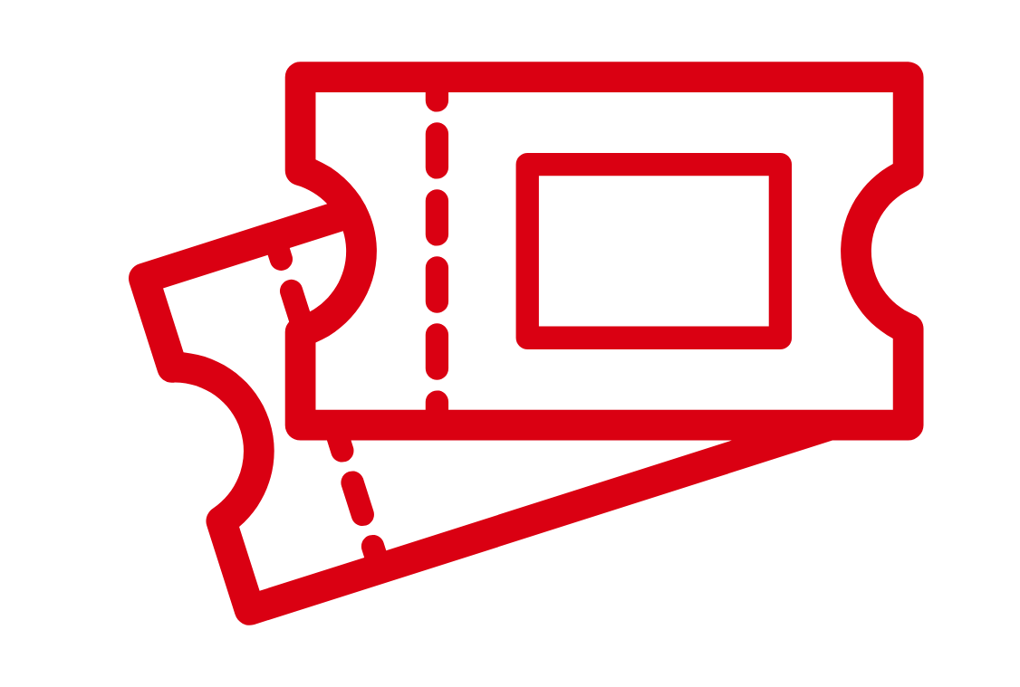
Spending Scenario 4
Theme park
Ways to Pay
Mr Spendalot is planning a trip to a theme park with his friends. The entry ticket will cost £15. He doesn’t have any cash or any money in his bank account. He has a £5 gift card.
How much does it cost?
Has he got enough money?
Does he need the item?
How will he pay?
Consequences?
Notes:
Spending Scenario 4: Theme Park: Mr Spendalot is already planning the trip to the theme park but doesn’t have enough money yet to buy the ticket. He has a £5 gift card so he needs £10 more. Mr Spendalot could:
Borrow the money by using his credit card. He will have to pay back more than he borrows. The longer he takes to pay back the borrowed money, the more interest he will have to pay. Is going to the theme park ‘worth’ more than £15? How much more?
Decide not to go on the trip. Does Mr Spendalot ‘need’ or ‘want’ to go to the theme park? Is it an essential (something we need to survive) or a luxury (something we want but that isn’t essential to our survival)?
Save up the money. How long would it take if he saved 50p a week? Or £1 a week? Or £2 a week? What if the trip were planned for this weekend? How could he get the money?

Slide 23
Today we have learnt…
Ways to Pay
About different ways we can pay for things without using cash
That a debit card is used to spend money from a bank account and a credit card is used to borrow money that has to be paid back
How to make spending choices and decide which method of payment to use
Give Mr Spendalot some advice to show what you have learnt today.
Notes:
Spending Dilemmas
In pairs or small groups, ask the children to work through the other Spending Dilemmas in their own time using the Decision Tree to help guide their choices. The cards are colour coded to allow for differentiation.
Invite some of the children to present their advice for Mr Spendalot and Mrs Thrifty on the spending dilemmas to the rest of the class. Ask the other children if they agree. What other choices could they make? What advice would they give?

Slide 24
What am I?
Ways to Pay
I am extra money you have to pay to the bank if you buy something using a credit card.
What am I?
Notes:
Challenge the pupils to another round of ‘What am I?’ to make sure they have understood the key points from the lesson.
(These are the same slides from earlier in the lesson, just in a different order.)

Slide 25
What am I?
Ways to Pay
I am extra money you have to pay to the bank if you buy something using a credit card.
What am I?
I am interest.
+

Slide 26
What am I?
Ways to Pay
You use me to spend money from your bank account.
What am I?

Slide 27
What am I?
Ways to Pay
You use me to spend money from your bank account.
What am I?
I am a debit card.
6543 2109 8765 4321
EXP 06/22

Slide 28
What am I?
Ways to Pay
You can use me like cash to buy things in a store, and your change stays on the card.
What am I?

Slide 29
What am I?
Ways to Pay
You can use me like cash to buy things in a store, and your change stays on the card.
What am I?
I am a gift card.

Slide 30
What am I?
Ways to Pay
If you use me to buy something you will owe money to the bank.
What am I?

Slide 31
What am I?
Ways to Pay
If you use me to buy something you will owe money to the bank.
What am I?
I am a credit card.
1234 5678 9012 3456
EXP 01/22

Slide 32

Ways to Pay

