Slide 1
Household Budgeting
Notes:
This lesson is designed to help children understand regular household expenses such as rent, council tax, utility bills and food. It introduces them to the concept of budgeting and to a simple monthly budget planner. The children also complete a payslip with pay and deductions to work out if a fictional character is earning enough to balance his budget.

Slide 2
Household Budgeting
2
Learning Objectives
To manage money
To understand the important role money plays in our lives

Slide 3
Household Budgeting
Today we will learn…
To identify a range of common household expenses
How to use simple financial information to plan and manage a basic budget
That planning our spending can help us stay in control of our money
That money is deducted from earnings to provide things we all need e.g. through taxes and National Insurance contributions

Slide 4
Introducing Billy…
Household Budgeting
Notes:
Introduce the class to Billy, who’s always running out of money. He is going shopping but hasn’t a clue how much it is going to cost.

Slide 5
Billy’s Shopping List
Household Budgeting
Pint of milk
Orange squash
Apples
Potatoes
Broccoli
Chicken
Toilet rolls
Washing up
liquid
Globe artichoke
Spaghetti
Notes:
Show the class the items on Billy’s shopping list. In pairs, ask the children to estimate how much they think each item on Billy’s shopping list might cost, and add them up to estimate a total for all the items. (You can use the Shopping List handout for this if you wish or use whiteboards).

Slide 6
Billy’s Shopping List
Total
£16.25
Household Budgeting
50p
85p
£1
70p
65p
Pint of milk
Orange squash
Apples
Potatoes
Broccoli
£3
£3
£3.30
£1.50
£1.75
Chicken
Toilet rolls
Washing up
liquid
Globe artichoke
Spaghetti
Notes:
Discuss the correct prices and total cost. Did most of the children estimate more or less than the correct total? Who got closest? Did anyone get the individual prices correct? Are they surprised by the real prices?

Slide 7
Household Budgeting
Budgets and budgeting
A budget
A plan for how you will use the money available to you over a specific time period (like a day, week, month or year).
Budgeting
The process of managing your money so you know how much you have and how much you can spend.
Notes:
Explain that almost everything in life costs money but we only have a fixed amount to spend. How can Billy spend his money wisely if he doesn’t know much things cost? It is important that we know the price of the things we have to buy so we can keep within our budget. Use this slide to explain what is meant by ‘a budget’ and ‘budgeting’.

Slide 8
Billy’s New Home
Notes:
Billy’s new home
Explain to the children that Billy wants to move into a new home with his partner and two children but he’s worried that he won’t be able to afford it. Working in pairs, ask children to identify all the things in Billy’s home that will cost money.
This activity can be completed using the image on the slide and whiteboards, or you can print copies of the worksheet for the children to write on. If there is time, the children can add more items to Billy’s home that they think he and his family may need or want.
Billy’s household costs
Ask the class for feedback about the types of costs Billy and his family might face in their new home. What will Billy need to buy? What does each room need? What will Billy’s family need? What bills should Billy expect?
Make sure the following costs are discussed, even if the children don’t suggest them: rent/mortgage payment, council tax, utilities, TV licence, Internet/TV package, basic food/household items, basic clothes, phone (landline/mobile).

Slide 9
Household Budgeting
Rent
If you don’t own your home, you will usually make regular payments, called rent, to the person that owns it. The amount of rent paid is different for everyone and depends on things like the size and location of the property.
Mortgage Repayment
Many people who own their home will have borrowed money from the bank to buy it. This loan is known as a mortgage. You repay the loan to the bank in monthly payments.
Notes:
Work through the definitions on slides 9 to 16 (you can also print copies of the Household Cost cards with these definitions for children to refer to later). Ask them to group the costs into three categories: fixed household costs; essential living costs: and non-essential living costs. (See the definitions on slide 17 and the suggested categorisations on the Teacher’s Copy of the budget planner resource.)
Acknowledge that not everyone will agree. For example, some people think a phone or an internet/TV package is essential. Others may think we can manage without. Some items such as food might appear in two categories: basic food such as bread and milk are essential, whereas other food like ice-cream is non-essential (luxuries). Swimming lessons and magazines are also non-essential, even if they are very enjoyable.
Explain that the next step is to find out the price of each item and to lay the information out in a clear and simple way that Billy can understand.

Slide 10
Council Tax
Household Budgeting
A payment every household must make to their local council to cover the cost of local services. These services include things like libraries, the police, fire service, rubbish collection, street cleaning, parks, and looking after children and elderly people.
Every house receives an annual council tax bill which can be paid in monthly payments.

Slide 11
Utilities
Household Budgeting
These include gas and electricity (energy), and water.
Energy is used for lighting, cooking and heating.
Water includes clean drinking water and a sewer connection for waste water.
The amount you pay will vary depending on how much you use and which company provides the services.

Slide 12
Household Budgeting
TV Licence
You must have a TV licence if you watch or record programmes as they’re being shown on TV or programmes shown live on a website.
This could be on any device, including a TV, desktop computer, laptop, mobile phone, tablet, or games console.

Slide 13
Internet/TV Packages
Household Budgeting
These allow you to access the internet in your home (from any device), and to watch a whole range of channels on your TV.
Costs vary depending on how fast the internet it, how much data you can use, and how many channels you have access to.

Slide 14
Basic food and household items
Household Budgeting
These include staple foods like bread, milk, fruit, meat, fish, fruit and vegetables and items used regularly in the home like laundry liquid, cleaning products and toilet rolls.
Basic clothes
These include clothes to wear to school or work, coats for cold weather and shoes etc.

Slide 15
Phone
Household Budgeting
Homes may have a landline telephone which can make and receive calls.
People often own or rent mobile phones which can be used to make and receive calls and text messages.

Slide 16
Swimming lessons
Household Budgeting
Ice-cream
Magazines

Slide 17
Cost categories
Household Budgeting
Fixed household costs
Things we ‘need’ that cost the same amount every month.
Essential living costs
Things we ‘need’ but the costs can change from month to month, or you may only have to pay for them a few times a year.
Non-essential living costs
Things we want but don’t necessarily need.

Slide 18
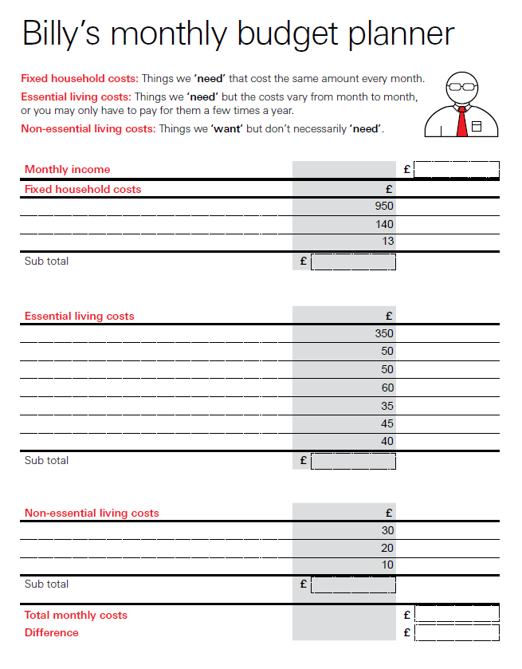
Billy’s monthly budget planner
Household Budgeting
Put the expenses in the correct category
Match the expense to the correct price
Calculate the total monthly cost
Notes:
Billy’s monthly budget planner
Hand out copies of Billy’s Monthly Budget Planner. Familiarise them with the layout; the sections for the three categories of costs: columns for the prices; sub totals; a space for the total cost. Explain this type of planner helps to sort and organise financial information. Billy can also use it to keep a record of his costs over time. Emphasise that the planner is for Billy’s monthly expenses. He could use a similar planner for his expenses each day, week, year, or for the costs of a holiday or birthday party he might be planning.

Slide 19
Swimming lessons
Household Budgeting
Council Tax
TV Licence
Rent/ mortgage
Utilities
Ice-cream
Phone
Basic food and household items
Basic clothes
Internet/TV Package
Magazines
Notes:
Working in pairs, their task is to put each of the Household Costs (from this slide) into the correct category and match it to the correct price. They can use the definitions of fixed, essential and non-essential costs to help guide their choices. To help guess the correct prices, they should consider which items are more or less expensive. Is electricity likely to be more, or less, expensive than rent/mortgage each month? Is council tax likely to be more, or less, expensive than water? They also need to add up all the costs to find the total.

Slide 20
Fixed household costs
Household Budgeting
Fixed household costs | £
Rent/Mortgage | 950
Council Tax | 140
TV licence | 13
Sub total | £1103
Notes:
Billy’s monthly budget planner – see Teacher’s Copy for the answers
Have pairs swap papers so they can mark each other’s work. Tell the children to award two points for each item that has been matched to the correct price, and one point for each item that has been put in the correct category (fixed, essential, non-essential) but against the incorrect price.
* Internet/TV package and phone costs are arguably non-essential living costs, so pupils can be awarded points for grouping them in either category.
Find out which pair got the highest score. Ask if anyone was surprised about the costs. Were they more or less than they expected? Acknowledge that some households will have higher or lower costs than Billy’s. It often depends on the size of the house and the number of people who live there.

Slide 21
Essential living costs
Household Budgeting
Essential living costs | £
Basic food and household items | 350
Gas | 50
Electricity | 50
Internet/TV Package | 60
Water | 35
Phone | 45
Clothes | 40
Sub total | £630

Slide 22
Non-essential living costs
Household Budgeting
Non-essential living costs | £
Swimming lessons | 30
Magazines | 20
Ice-cream | 10
Sub total | £60

Slide 23
Total monthly costs
Household Budgeting
Monthly costs | £
Fixed household costs | 1103
Essential living costs | 630
Non-essential living costs | 60
Total monthly costs | £1793

Slide 24
Billy’s new job
Household Budgeting
Notes:
Billy’s monthly payslip
Billy has recently started a new job as a zookeeper. He’s really looking forward to being paid but he can’t work out how much he will be paid. Will it be enough to cover all his household costs?

Slide 25
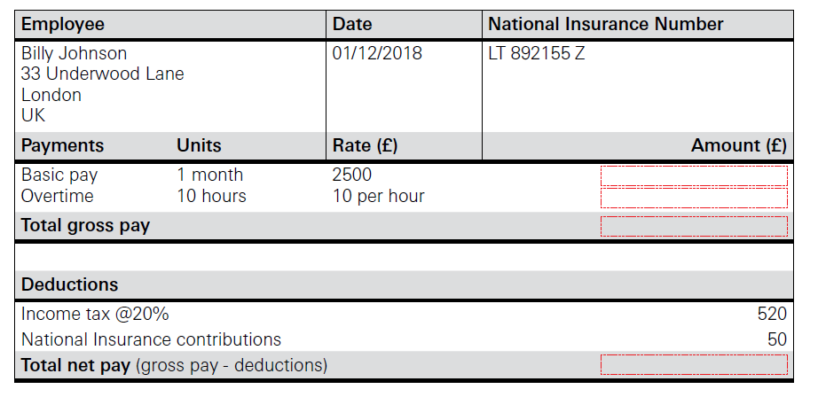
Billy’s monthly payslip
Household Budgeting
Notes:
Give pairs a copy of Billy’s Monthly Payslip. Point out the main features and explain the terminology using the information provided. Ask the children to label the different features using the numbering on the worksheet as you go along.
Work through the calculations and ask the children to complete the payslip with the correct figures. Explain that Billy can’t keep all the money he has earnt; some deductions are made. Have the children heard of income tax or national insurance? Where does the money go? What is it used for?

Slide 26
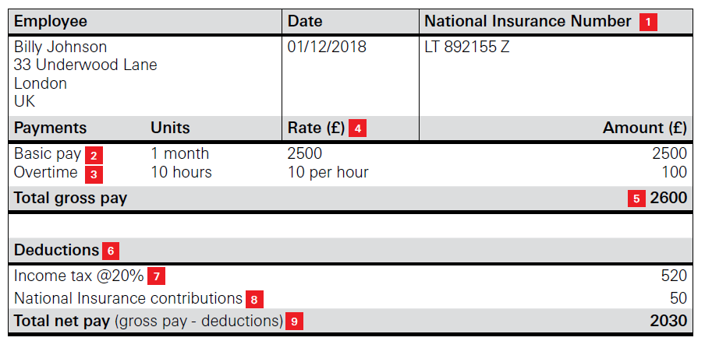
Billy’s monthly payslip
Household Budgeting
Notes:
Finish by calculating Billy’s net pay. This is often called ‘take-home’ pay as it is the amount Billy will take home after the deductions have been made.

Slide 27
Balancing Billy’s Budget
Household Budgeting
Income | £ | £2030
Fixed household costs | 1103
Essential living costs | 630
Non-essential living costs | 60
Total monthly costs | £1793 | - £1793
Difference |  | £237
Notes:
Balancing Billy’s monthly budget
Ask the children to return to their copy of Billy’s Monthly Budget Planner. They should write Billy’s net pay at the top and then deduct his total household costs. Ask the children if Billy will have any money left over at the end of the month. What could, or should, Billy do with any money that is left over? Spend it? What on? Save it? What for? Give it away? Who to? What if Billy wasn’t earning enough to pay all his household costs? How could he adjust his budget? Which costs could he reduce?

Slide 28
Today we have learnt…
Household Budgeting
A range of regular household expenses
How to use simple financial information to plan and manage a basic budget
That planning our spending can help the us stay in control of our money
That money is deducted from earnings to provide things we all need e.g. through taxes and National Insurance Contributions

Slide 29

Household Budgeting

