Slide 1

SECTION 1
Managing
My Money
SECTION 1
Managing
My Money
9
Spending Sense
9
Spending Sense

Slide 2



Spending Sense
Editable PowerPoint Guide ​
Who are these PowerPoints for?​
These editable PowerPoints are designed for both teachers and students. ​
Teachers can easily adapt the slides to fit their students’ needs, while students can work directly on the activities by adding text, matching images to words, and more. ​
Please go to the next slide to jump to the activity required.
How can I use them?
There are many ways to use these PowerPoints! You can:​
Edit and print them​
Project them on screen ​
Let students work on them directly from a computer​
Note: before editing them, we'd suggest saving another copy!​
How do I edit them?​
Every element on the activity pages is fully editable. You can: ​
Change images or text (content, font, size, colour)​
Add new text​
Customise the background colour​
Try editing an example for yourself here:​
IN-APP PURCHASE
£2.99
How do I access the audio? ​
Tasks with longer text in this resource comes with accompanying audio.
Simply click the audio button to listen.
Income
Mo is 18 and goes to college.
He earns £7 an hour for working in a sports shop at the weekend.
He works eight hours a week and earns £240 a month.

Slide 3

SECTION 1
Managing
My Money
Click below to jump to:
SECTION 1
1.1 Money, money, money
1.2 Getting to grips with change
1.3 Needs and wants
1.4 Managing my money
1.5 Bedroom on a budget
1.6 Saving... Every little helps
1.7 Seeking financial help and advice

Slide 4
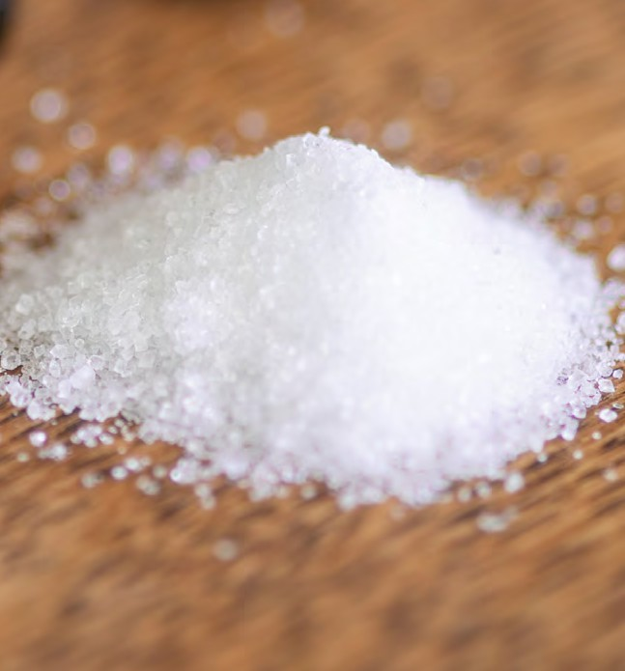
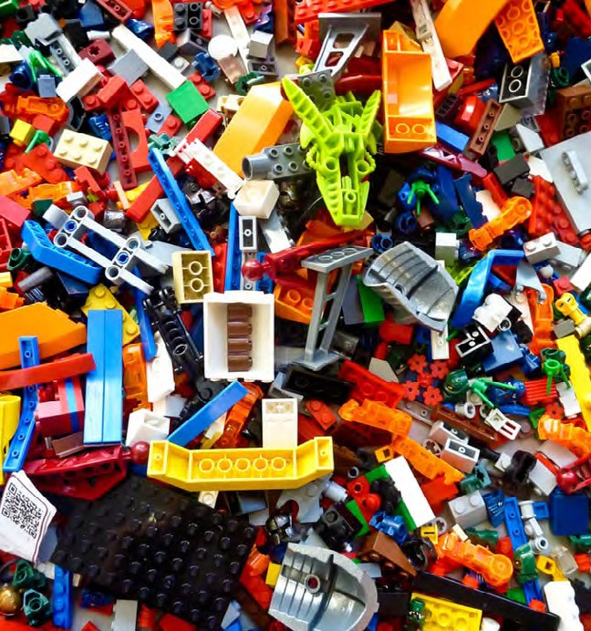
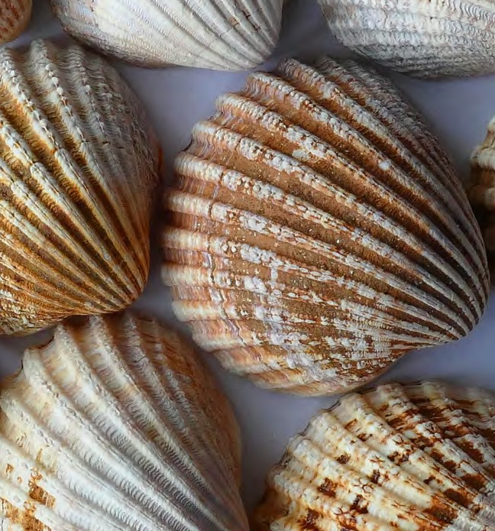



Is This Money?
SECTION 1:1 | MANAGING MY MONEY
TASK ONE - ACTIVITY SHEET
EDUCATOR NOTES
Look at the images below and circle all the items that have been used as a form of money in the past.
Salt
Lego
Shells
Eggs
Knives
Sweets
Why do you think that the ones you have NOT circled should not be used as money?
Spending Sense | Money, money, money!
Section 1:1 | Managing my money
15

Slide 5

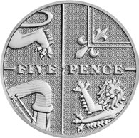
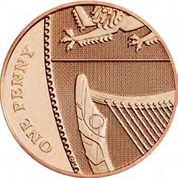
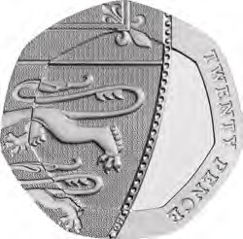
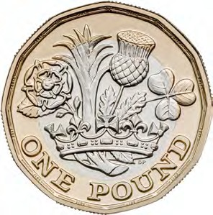
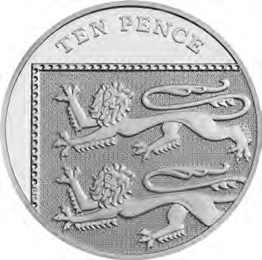
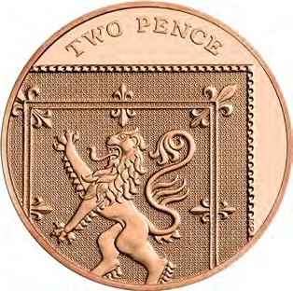
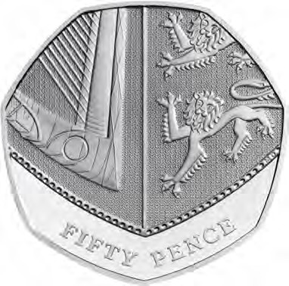
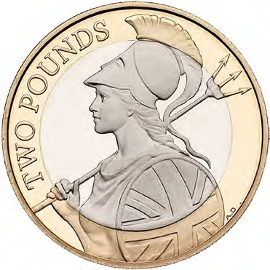
Coin Template
SECTION 1:1 | MANAGING MY MONEY
TASK TWO - ACTIVITY SHEET
EDUCATOR NOTES
EDIT ME
IN POWER
POINT
Identify each coin and cut them out.
Use your coins to make:
Can you find other ways to get to these amounts?
£3.80
£4.87
£2.15
£1.24
Spending Sense | Money, money, money!
Section 1:1 | Managing my money

Slide 6





The Coin Challenge
SECTION 1:1 | MANAGING MY MONEY
TASK THREE - ACTIVITY SHEET
EDUCATOR NOTES
BOOK | SWEETS | SUNGLASSES
£3.75 | £1.25 | £5.00
CUCUMBER | STATIONERY SET | TOOTHPASTE
£0.87 | £4.56 | £2.63
Spending Sense | Money, money, money!
Section 1:1 | Managing my money

Slide 7





Shopping List A (Less than £10)
SECTION 1:2 | MANAGING MY MONEY
TASK ONE - ACTIVITY SHEET
EDUCATOR NOTES
IN-APP PURCHASE | LOOT BOX FOR ONLINE GAME | DEODORANT
£2.99 | £4.50 | £1.89
TOOTHBRUSH | MONTHLY STREAMING MUSIC SERVICE | SMOOTHIE
£1.49 | £9.29 | £3.35
SANDWICH MEAL | CINEMA TICKET | STATIONERY
£3.60 | £7.79 | £4.00
BOOK
£5.78
Spending Sense | Getting to grips with change
Section 1:2 | Managing my money

Slide 8
Record Sheet (For shopping list A)
SECTION 1:2 | MANAGING MY MONEY
TASK ONE - ACTIVITY SHEET
EDUCATOR NOTES
What did you pick?
What is its value?
How much money do you have?
What is your change?
Spending Sense | Getting to grips with change
Section 1:2 | Managing my money

Slide 9





Shopping List B (More than £10)
SECTION 1:2 | MANAGING MY MONEY
TASK TWO - ACTIVITY SHEET
EDUCATOR NOTES
TICKET FOR A CONCERT | PHONE CASE | MOBILE PHONE MONTHLY CONTRACT
£45.50 | £18.57 | £35.00
MONTHLY GYM MEMBERSHIP | TRAINERS | HOODIE
£19.99 | £44.99 | £39.49
TICKET FOR A SPORTING EVENT | PREMIUM DIGITAL STREAMING SERVICE | TAKEAWAY WITH FRIENDS
£36.79 | £12.79 | £10.65
BIRTHDAY GIFT
£20.37
Spending Sense | Getting to grips with change
Section 1:2 | Managing my money

Slide 10
Record Sheet (For shopping list B)
SECTION 1:2 | MANAGING MY MONEY
TASK TWO - ACTIVITY SHEET
EDUCATOR NOTES
What did you pick?
What is its value?
How much money do you have?
What is your change?
Spending Sense | Getting to grips with change
Section 1:2 | Managing my money

Slide 11

How digital payments work
Fill in the blanks below
SECTION 1:2 | MANAGING MY MONEY
TASK THREE - ACTIVITY SHEET
EDUCATOR NOTES
Scenario A: Buying Online
Sarah was browsing for clothing online using her She found a t-shirt she loved on a shopping website and paid for it online, with her She put the item in her virtual ‘bag’ and clicked ‘check out’. When prompted she then checked the payment amount and then entered her personal information, including her name and in the boxes on screen. Once she saw the total amount to pay, which included a delivery charge, she confirmed the transaction and then received an stating that her order had been approved. Sarah then waited for the t-shirt to be to her home.
See the next slide for Scenario B.
Spending Sense | Getting to grips with change
Section 1:2 | Managing my money

Slide 12

How digital payments work
Fill in the blanks below
SECTION 1:2 | MANAGING MY MONEY
TASK THREE - ACTIVITY SHEET
EDUCATOR NOTES
Scenario B: Chip and Pin
Davide always pays for his weekly food shopping using his debit card. One week Davide spent over £100 on his shopping at a big supermarket, so he needed to enter his debit card into the He placed his card in the reader with the facing upwards. He then entered his
and the transaction completed. When he got home, Davide checked his bank online and could see that the payment for his shopping earlier that day had been taken by the supermarket, just as he expected.
See the next slide for Scenario C.
Spending Sense | Getting to grips with change
Section 1:2 | Managing my money

Slide 13


How digital payments work
Fill in the blanks below
SECTION 1:2 | MANAGING MY MONEY
TASK THREE - ACTIVITY SHEET
EDUCATOR NOTES
Scenario C: Using Contactless
Emilia was out for lunch with her friends.
They finished their food and asked for the When the bill arrived, Emilia and her friends decided that they would each work out what they had spent and pay for their food separately. Emilia worked out how much she needed to pay for her food. Everyone chose to pay using their The waiter brought the to the table.
Emilia told the waiter how much of the bill she needed to pay and lined up her contactless symbol on her debit card to the on the card reader. She then tapped the card reader with her card and waited for the transaction to complete. the waiter told Emilia that her had gone through and he moved onto the next person for them to pay their part of the bill.
See the next slide for Scenario D.
Spending Sense | Getting to grips with change
Section 1:2 | Managing my money

Slide 14


How digital payments work
Fill in the blanks below
SECTION 1:2 | MANAGING MY MONEY
TASK THREE - ACTIVITY SHEET
EDUCATOR NOTES
Scenario D: Paying by Phone
Theo went to his local corner shop to buy some snacks but realised when he got to the till to pay that he had forgotten his wallet. He did however have his phone with him. Theo had previously stored his debit card electronically into his
on his phone. So, he decided to use his to pay for the items. He found his digital wallet on
his phone, selected his as the payment method and tapped it against the
symbol on the shop’s The transaction completed and he took his snacks home, but not before eating some on the way back!
Spending Sense | Getting to grips with change
Section 1:2 | Managing my money

Slide 15
Cash or Digital
SECTION 1:2 | MANAGING MY MONEY
TASK FOUR - ACTIVITY SHEET
EDUCATOR NOTES
Using the shopping lists, decide which items you are more likely to pay for using cash and which items you are more likely to buy using digital methods.
Cash | Digital
Spending Sense | Getting to grips with change
Section 1:2 | Managing my money

Slide 16
Cash or Digital
SECTION 1:2 | MANAGING MY MONEY
TASK FOUR - ACTIVITY SHEET
EDUCATOR NOTES
The benefits of using cash are...
The disadvantages of using cash are...
The benefits of using digital methods are...
The disadvantages of using digital methods are...
Spending Sense | Getting to grips with change
Section 1:2 | Managing my money

Slide 17
SECTION 1:3 | MANAGING MY MONEY
TASK ONE - ACTIVITY SHEET
EDUCATOR NOTES
Cut out the pictures and stick them in either the Needs column or the Wants column. Think about why it is a Need or a Want.
Needs | Wants
Spending Sense | Needs and wants
Section 1:3 | Managing my money

Slide 18

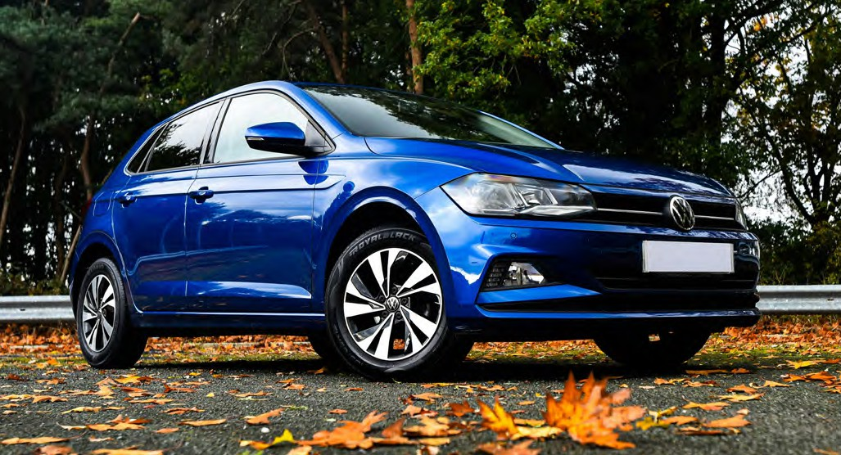



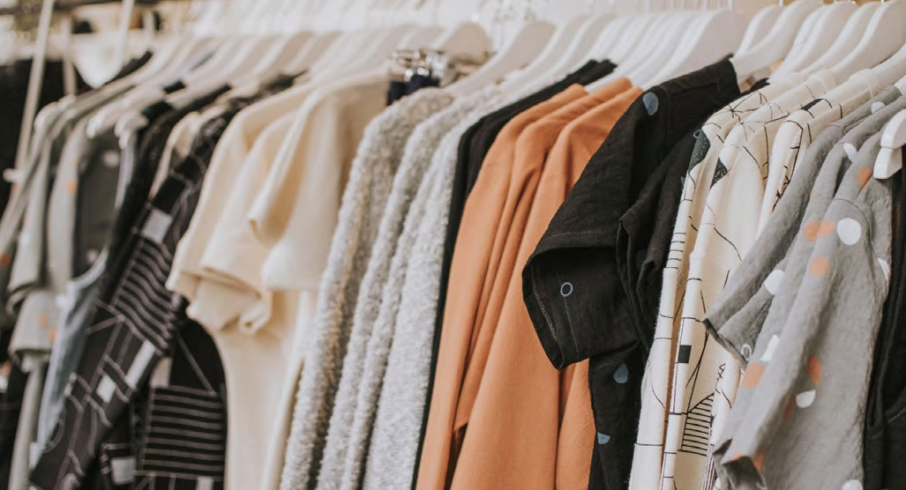
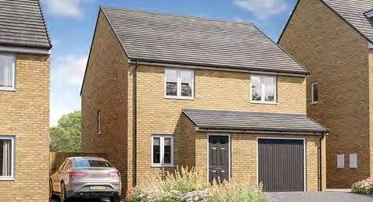
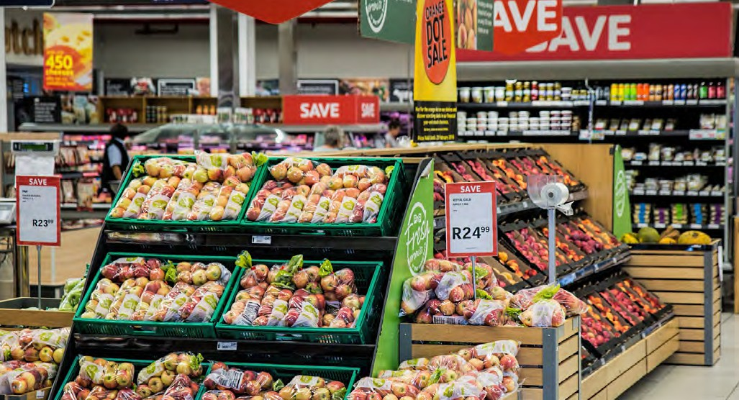


SECTION 1:3 | MANAGING MY MONEY
TASK ONE - ACTIVITY SHEET
EDUCATOR NOTES
Cut out the pictures and stick them in either the Needs column or the Wants column. Think about why is it a Need or a Want?
Spending Sense | Needs and wants
Section 1:3 | Managing my money

Slide 19

Francine’s Case Study
SECTION 1:3 | MANAGING MY MONEY
TASK TWO - ACTIVITY SHEET
EDUCATOR NOTES
Hi, I was wondering if you could give me some advice.
I am not sure how to manage my money.
I get paid from my job tomorrow and I can either buy a new pair of trainers or I can do my monthly food shop.
I’ve also seen a great holiday advertised so I’m thinking about booking it, but I have to pay my rent next week and I can’t afford both.
I also need to replace my work uniform and buy the kids new school shoes, but I’d rather spend it on a new gaming console for my son – he deserves a treat.
Please help me!
Francine’s List
New pair of trainers
Gaming console for son
Rent
New school shoes for the kids
Holiday to Spain
Food for the month
New uniform for work
Spending Sense | Needs and wants
Section 1:3 | Managing my money

Slide 20
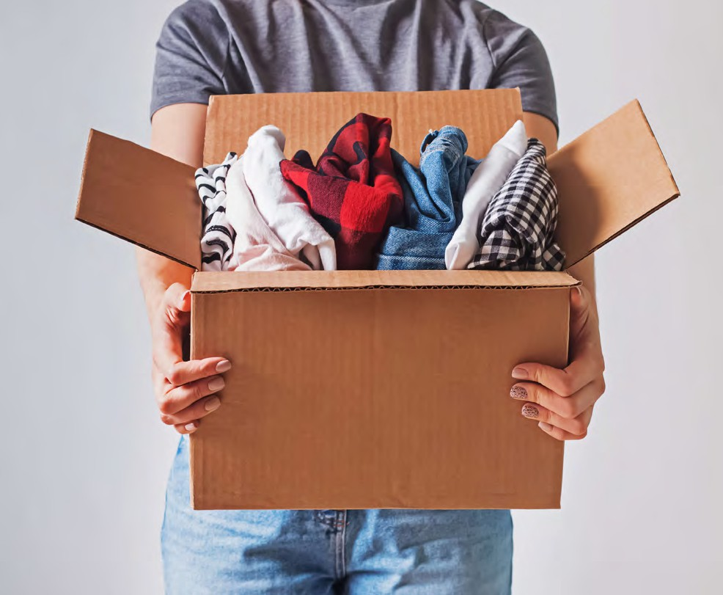

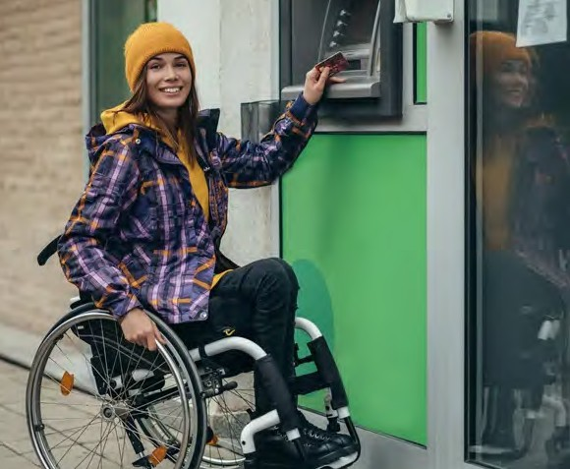

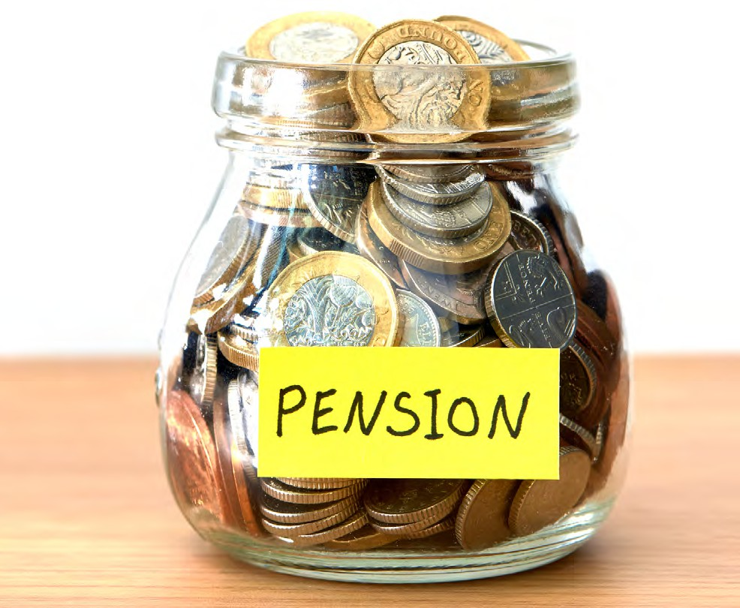
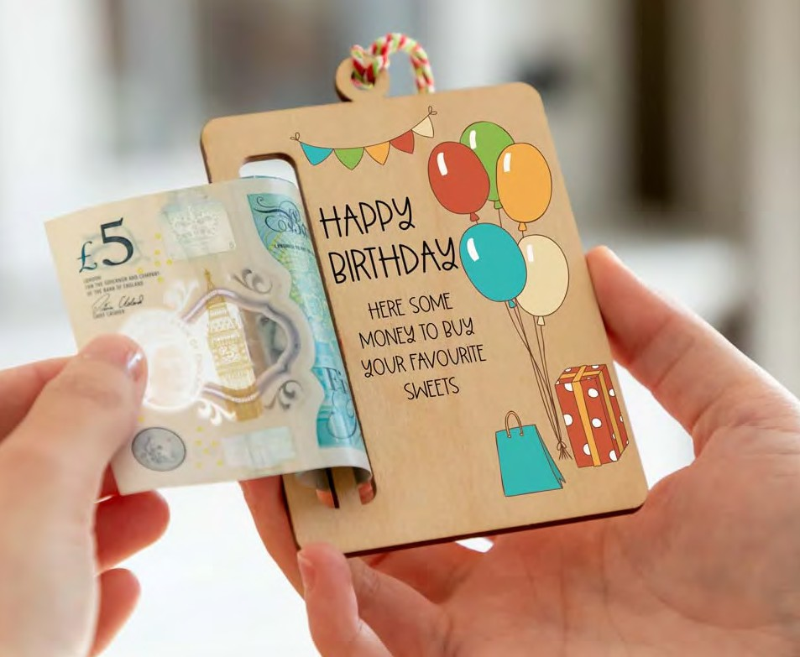
Forms of income
SECTION 1:4 | MANAGING MY MONEY
TASK ONE - ACTIVITY SHEET
EDUCATOR NOTES
Spending Sense | Managing my money
Section 1:4 | Managing my money

Slide 21

Ella’s Case Study
SECTION 1:4 | MANAGING MY MONEY
TASK TWO - ACTIVITY SHEET
EDUCATOR NOTES
Ella is 16 and is wondering why she never has any money left at the end of the month.
She has asked you to help her find out why this might be and to see if there is any way she can cut down on her spending and try to save a little bit of money too.
Ella’s income:
She gets £80 per month pocket money for helping out around the house and doing jobs for her grandparents.
Ella’s expenditure:
Ella’s expenses (per month)
Amount
Phone
£15
Snacks/drinks
£30
Online subscription
£10
Toiletries
£15
Gym membership
£20
Spending Sense | Managing my money
Section 1:4 | Managing my money

Slide 22
SECTION 1:4 | MANAGING MY MONEY
TASK TWO - ACTIVITY SHEET
EDUCATOR NOTES
5. Put together a new spending budget for Ella, below.
Ella’s Expenses
Amount (£)
Total
6. Suggest how Ella could start to save some money each month.
Spending Sense | Managing my money
Section 1:4 | Managing my money

Slide 23
Mo’s Case Study
SECTION 1:4 | MANAGING MY MONEY
TASK TWO - ACTIVITY SHEET
EDUCATOR NOTES
Income
Mo is 18 and goes to college.
He earns £7 an hour for working in a sports shop at the weekend.
He works eight hours a week and earns £240 a month.
Expenses
Mo has a bus pass to get to college and work which costs him £40 per month.
He likes to go to the cinema every week and spends £10 on a ticket and a snack every visit.
He spends £50 a month on his phone and loves buying new clothes and trainers, spending about £100 per month.
1. How much is Mo spending per month?
2. Is he overspending? If so, by how much?
3. How can Mo change his spending habits to balance his budget?
Spending Sense | Managing my money
Section 1:4 | Managing my money

Slide 24



SECTION 1:4 | MANAGING MY MONEY
TASK THREE - ACTIVITY SHEET
EDUCATOR NOTES
Monthly Income Cards
Doing chores at home
Saturday job at the local shop
Pocket money
£40
£80
£36
Cutting the neighbours grass
Money from grandparents
Washing the car
£20
£10
£8
Dog Walking
Newspaper delivery
Gardening
£24
£22
£30
Café work
Babysitting
Selling unwanted items
£48
£18
£10
Spending Sense | Managing my money
Section 1:4 | Managing my money

Slide 25
Monthly Expenditure Cards
SECTION 1:4 | MANAGING MY MONEY
TASK THREE - ACTIVITY SHEET
EDUCATOR NOTES
 | Sweets £16 |  | Ice cream £6 | Iced-coffee £4.50 | Phone apps £6
Video game £45 |  |  | Toiletries £15 | Snacks/drinks £20 | Match cards £12
Phone top-up £15 |  |  | Cinema ticket £5 | Football match £15 | Music downloads £8
Bowling £10 |  |  | Swimming pool entry £3.50 | Music lesson £9 | Gym session £5.50
 |  | Clothing £25 | Books £10 | Savings £5 | In-app purchases £10
Spending Sense | Managing my money
Section 1:4 | Managing my money

Slide 26




Budget Cards
SECTION 1:5 | MANAGING MY MONEY
TASK ONE - ACTIVITY SHEET
EDUCATOR NOTES
You have a budget of £350 | You have a budget of £500
You have a budget of £750 | You have a budget of £1000
Spending Sense | Bedroom on a budget
Section 1:5 | Managing my money

Slide 27
Budget Sheet
SECTION 1:5 | MANAGING MY MONEY
TASK ONE - ACTIVITY SHEET
EDUCATOR NOTES
Circle your total budget: £350, £500, £750 or £1000 or add a bespoke one here
ITEM | BUDGET | RETAILER/ITEM DESCRIPTION | ACTUAL PRICE
Essentials
Bed
Duvet and pillows
Duvet cover and pillowcase
Wardrobe
Side table and lamp
Curtains
Other items
TOTAL
Spending Sense | Bedroom on a budget
Section 1:5 | Managing my money

Slide 28
Room Plan
SECTION 1:5 | MANAGING MY MONEY
TASK THREE - ACTIVITY SHEET
EDUCATOR NOTES
Doorway
Window
Spending Sense | Bedroom on a budget
Section 1:5 | Managing my money

Slide 29

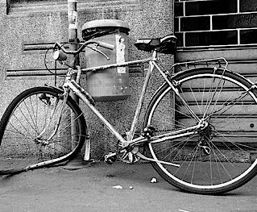


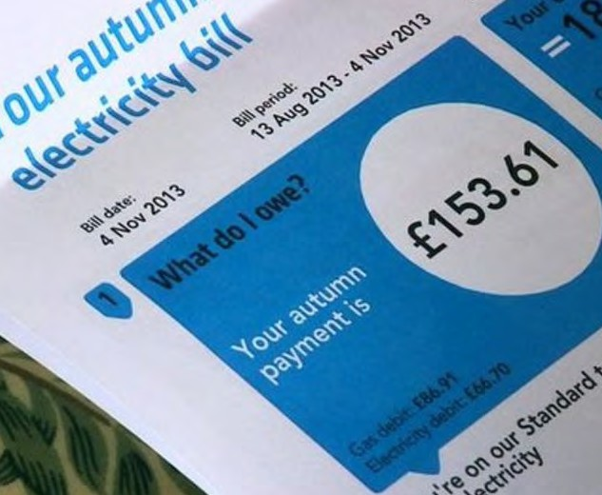

Why save?
SECTION 1:6 | MANAGING MY MONEY
TASK ONE - ACTIVITY SHEET
EDUCATOR NOTES
Spending Sense | Saving... every little helps
Section 1:6 | Managing my money

Slide 30





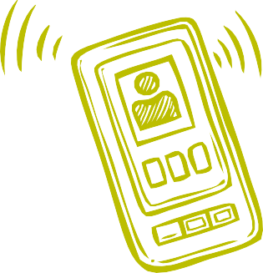
Saving Scenarios
SECTION 1:6 | MANAGING MY MONEY
TASK TWO - ACTIVITY SHEET
EDUCATOR NOTES
It’s Mum’s birthday in 6 weeks
The microwave is broken and we need a new one
I want to go on ‘the trip of a lifetime’
I need some new shoes
I want the latest designer jacket
I need a new phone
Spending Sense | Saving... every little helps
Section 1:6 | Managing my money

Slide 31
Saving Option Cards
SECTION 1:6 | MANAGING MY MONEY
TASK TWO - ACTIVITY SHEET
EDUCATOR NOTES
Set a savings budget and put money away each week or month
Shop around for the best deals
Put my change in a money box
Open a savings account at the bank
Sell unwanted items
Look at ways to spend less
Save £1 coins in a money box
Other
Spending Sense | Saving... every little helps
Section 1:6 | Managing my money

Slide 32
SECTION 1:7 | MANAGING MY MONEY
TASK ONE - ACTIVITY SHEET
EDUCATOR NOTES
Emotions about financial situations
Situation | How does this make me feel? Write your answer and/or include an emoji
I’m in debt and can’t afford to pay my rent
I don’t know how to manage my money
I’ve given someone my bank details and I don’t know if that person is trustworthy
I don’t know how to apply for benefits
I spend a lot of my wages on online gambling
I’ve bought a new phone which is faulty and customer services have been unhelpful
How could these situations affect a person’s health and wellbeing?
Why is it important to seek financial help and support?
Spending Sense | Seeking financial help and advice
Section 1:7 | Managing my money
63

