Slide 1

SECTION 2
Making Financial
Decisions
Spending Sense
66

Slide 2



Spending Sense
Editable PowerPoint Guide ​
Who are these PowerPoints for?​
These editable PowerPoints are designed for both teachers and students. ​
Teachers can easily adapt the slides to fit their students’ needs, while students can work directly on the activities by adding text, matching images to words, and more. ​
Please go to the next slide to jump to the activity required.
How can I use them?
There are many ways to use these PowerPoints! You can:​
Edit and print them​
Project them on screen ​
Let students work on them directly from a computer​
Note: before editing them, we'd suggest saving another copy!​
How do I edit them?​
Every element on the activity pages is fully editable. You can: ​
Change images or text (content, font, size, colour)​
Add new text​
Customise the background colour​
Try editing an example for yourself here:​
IN-APP PURCHASE
£2.99
How do I access the audio? ​
Tasks with longer text in this resource comes with accompanying audio.
Simply click the audio button to listen.
Income
Mo is 18 and goes to college.
He earns £7 an hour for working in a sports shop at the weekend.
He works eight hours a week and earns £240 a month.

Slide 3

SECTION 2
Making Financial
Decisions
Click below to jump to:
SECTION 2
2.1 Eat well for less
2.2 Ethical Spending
2.3 Why do I buy?
2.4 Gambling
2.5 Borrowing and debt
2.6 Understanding insurance
2.7 Opening a Bank Account

Slide 4
Recipe Cost Sheet
SECTION 2:1 | MAKING FINANCIAL DECISIONS
TASK TWO - ACTIVITY SHEET
EDUCATOR NOTES
Ingredients | Amount needed | £
TOTAL COST
Spending Sense | Eat well for less
Section 2:1 | Making Financial Decisions
70

Slide 5
Pizza Comparisons
SECTION 2:1 | MAKING FINANCIAL DECISIONS
TASK THREE - ACTIVITY SHEET
EDUCATOR NOTES
Pizza Option | Price (£) | Value for money (rank in order – 1 = cheapest, 3 = most expensive) | Healthy (rank in order – 1 = most healthy, 3 = least healthy)
Home made
Ready made
Takeaway
I would choose pizza
This is because...
Spending Sense | Eat well for less
Section 2:1 | Making Financial Decisions
71

Slide 6
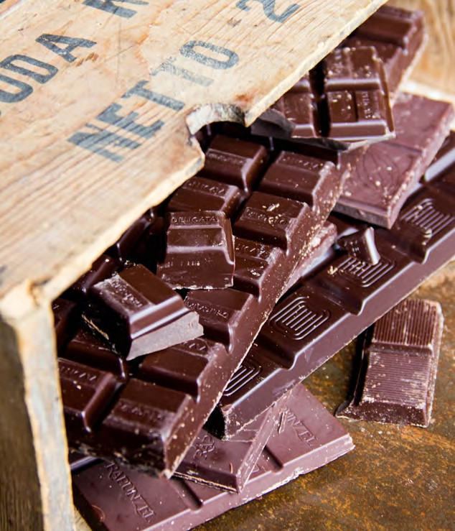
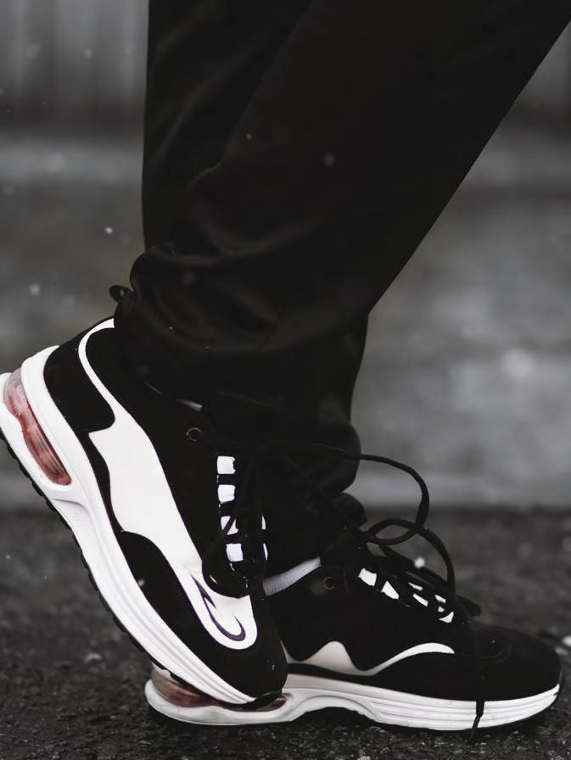
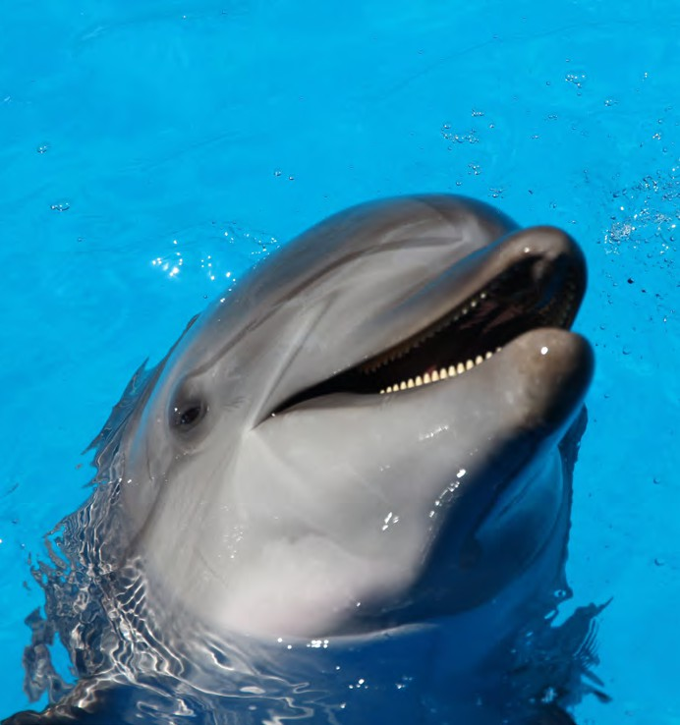
Ethical Scenarios
SECTION 2:2 | MAKING FINANCIAL DECISIONS
TASK ONE - ACTIVITY SHEET
EDUCATOR NOTES
Scenario One
Ade loves chocolate and tends to buy a bar a week for a treat.
He generally doesn’t pay much attention to the different types of chocolate available in the supermarket until he sees an advert on social media about a new brand of ethically sourced chocolate.
The chocolate bar costs more money but the cocoa farmers in Ghana, where it is produced, get a fair price for their beans.
Scenario Two
Demi loves wearing popular sportswear brands. One day she watches an online video about how her favourite t-shirts are made and it upsets her.
They are made by young children who work in factories working long hours for very little money.
Demi decides to stop buying her favourite brand and now always checks her clothing labels to make sure the clothes that she wears are made ethically.
They often cost more money and she is required to do more research about where her clothes are made.
Scenario Three
Rami has watched a documentary about how
10% of the whale and dolphin population have died due to consuming plastic that has been dumped in the sea.
Rami decides to stop using products that use plastic packaging to help save these animals.
However this means he has to travel further to buy items that he wants.
Spending Sense | Ethical spending
Section 2:2 | Making Financial Decisions
74

Slide 7
My Ethical Case Study
SECTION 2:2 | MAKING FINANCIAL DECISIONS
TASK ONE - ACTIVITY SHEET
EDUCATOR NOTES
You should include:
Your character
Information about the ethical issue
What your character does about the issue
How the character benefits from the product/the problem of buying the product
Spending Sense | Ethical spending
Section 2:2 | Making Financial Decisions

Slide 8
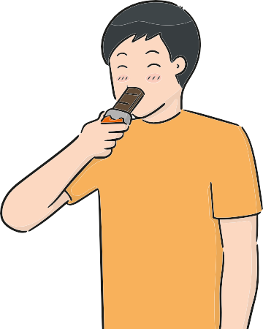
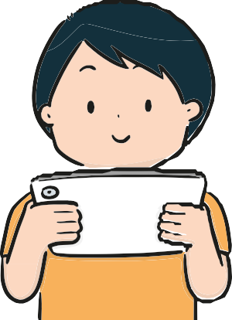

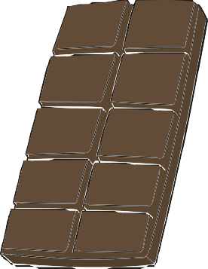
Comic Strip
SECTION 2:2 | MAKING FINANCIAL DECISIONS
TASK TWO - ACTIVITY SHEET
EDUCATOR NOTES
Read the comic strip about Ade and then choose one of the other case studies and design your own comic strip.
Ade loves chocolate. As a treat at the end of the week he buys himself
some. He picks the tastiest one there and dosen’t spend a lot of money.
While on social media he sees an advert for a new range of fair trade products and he researches more about fair trade and what it is.
Next time he is in the store he buys fair trade chocolate. Although it costs him more, he feels good that his money is going to the workers.
Spending Sense | Ethical spending
Section 2:2 | Making Financial Decisions

Slide 9
Comic Strip
SECTION 2:2 | MAKING FINANCIAL DECISIONS
TASK TWO - ACTIVITY SHEET
EDUCATOR NOTES
Read the comic strip about Ade and then choose one of the other case studies and design your own comic strip.
Spending Sense | Ethical spending
Section 2:2 | Making Financial Decisions

Slide 10

Social Media Post
SECTION 2:2 | MAKING FINANCIAL DECISIONS
TASK THREE - ACTIVITY SHEET
EDUCATOR NOTES
Using the template below, write a brief social media post including one financial benefit and one financial problem of buying ethical products.
Spending Sense | Ethical spending
Section 2:2 | Making Financial Decisions

Slide 11
Social Media Template
SECTION 2:3 | MAKING FINANCIAL DECISIONS
TASK THREE - ACTIVITY SHEET
EDUCATOR NOTES
Spending Sense | Why do I buy?
Section 2:3 | Making Financial Decisions
84

Slide 12
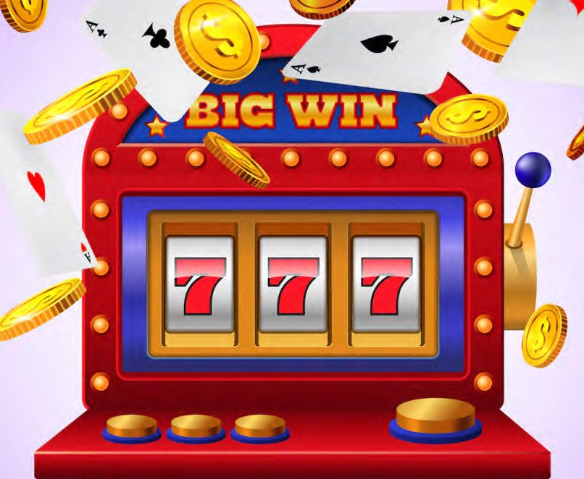


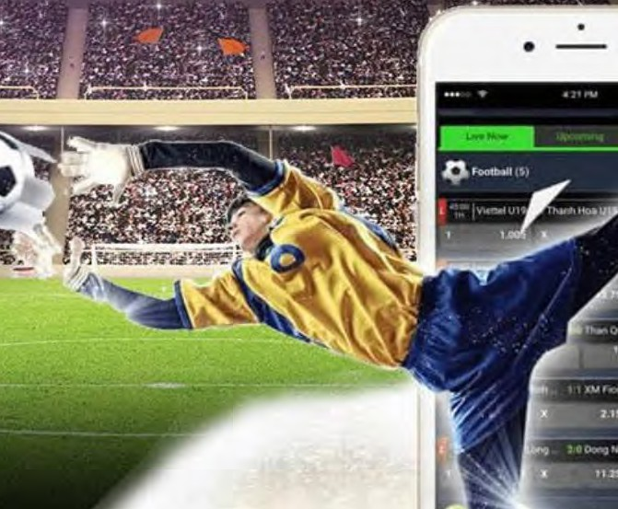
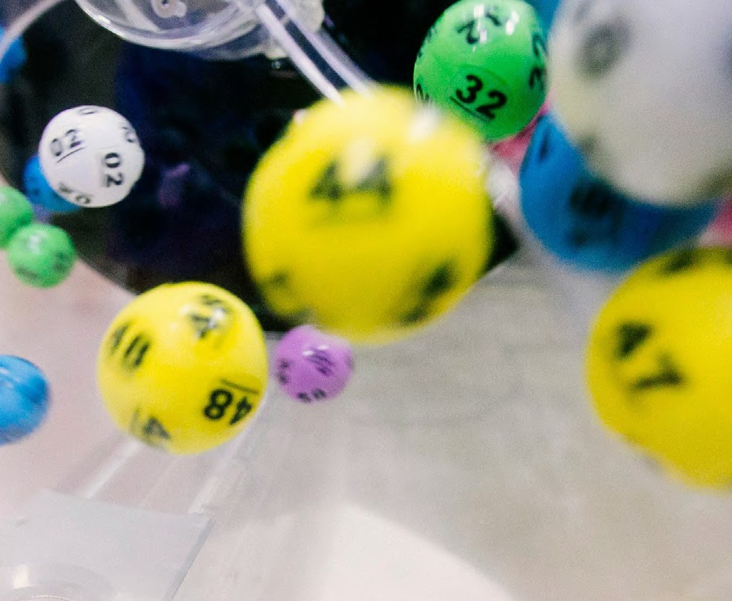
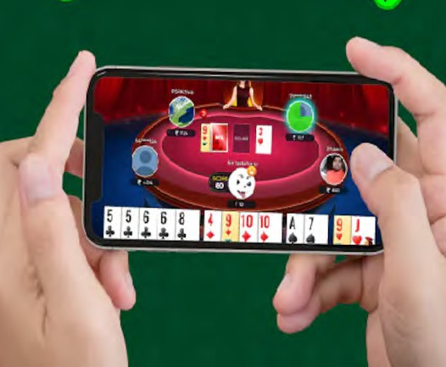
Gambling
SECTION 2:4 | MAKING FINANCIAL DECISIONS
TASK ONE - ACTIVITY SHEET
EDUCATOR NOTES
Spending Sense | Gambling
Section 2:4 | Making Financial Decisions
88

Slide 13

SECTION 2:4 | MAKING FINANCIAL DECISIONS
TASK TWO - ACTIVITY SHEET
EDUCATOR NOTES
Case Study One: Rosie’s Story
Lately I have been buying a lot of scratch cards and different types of lottery tickets. It started after I finished the grocery shopping and I had a little left-over change. So I decided to buy 3 scratch cards, and I won £15. I was delighted! But then the next time I went shopping I bought 7 scratch cards and only won £8.
Questions
How is Rosie taking risks?
How could this affect her family?
Should Rosie buy more scratch
cards in future?
However, the last time I went shopping I spent all my money on scratch cards and lottery tickets.
I did not even buy food! When I got home and added up all of the money I had won, it came to less than I had spent on the scratch cards in the first place.
Spending Sense | Gambling
Section 2:4 | Making Financial Decisions
89

Slide 14

SECTION 2:4 | MAKING FINANCIAL DECISIONS
TASK TWO - ACTIVITY SHEET
EDUCATOR NOTES
Case Study Two: Abdul’s Story
I love playing football video games and that is why I spent some of my birthday money on buying a random player pack to try and win my favourite player.
Questions
Is Abdul gambling?
Why do you think this?
What are the danger of in-game
purchases?
What should he do now?
What other ways do online games encourage you to spend money?
Sadly, I didn’t get him. So, I decided to spend a bit more of my birthday money to try and get him again. I did not. I was talking to my friend about the game and he told me he got him first time. So, I spent the rest of my birthday money trying but still didn’t get him. I felt upset as I had wasted all my birthday money.
Spending Sense | Gambling
Section 2:4 | Making Financial Decisions
89

Slide 15
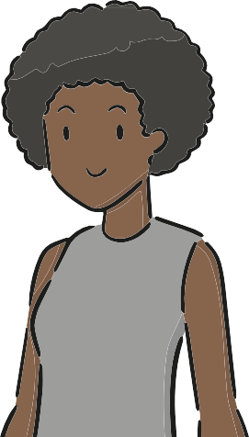
SECTION 2:4 | MAKING FINANCIAL DECISIONS
TASK TWO - ACTIVITY SHEET
EDUCATOR NOTES
Case Study Three: Sara’s Story
My mum had just told me about the National Lottery. I did not know much about it so I decided to do a bit of research. Did you know that to win the jackpot, you only have a 1 in 45,057,474 chance? In fact you are 70 times more likely to win an Olympic gold medal than to win the jackpot!
Questions
Did Sara do the sensible thing?
Would you still enter the lottery?
Why? Why not?
Are there any benefits of playing
the National Lottery?
If so, what are they?
Now, I am never entering the lottery and telling my mum about it!
Spending Sense | Gambling
Section 2:4 | Making Financial Decisions
89

Slide 16
Different types of borrowing
SECTION 2:5 | MAKING FINANCIAL DECISIONS
TASK ONE - ACTIVITY SHEET
EDUCATOR NOTES
Match the term to explanation
Personal Loan
Credit Card
Mortgage
Overdraft
Hire Purchase
Payday Loan
Loan Shark
Very short-term loans for small amounts of money. Intended for emergency borrowing only and usually have very high interest rates.
Can be used for buying a car or large household item. Repayments are made over a number of years, but you do not own whatever you have purchased until the final repayment has been made.
Allows you to use more money than you have in your bank account.
Money lent by an unlicensed lender, often someone in your local community. They charge extremely high rates of interest – you will pay back a lot more than you borrowed. Can be aggressive in seeking repayment.
When money is borrowed and paid back in monthly amounts. Usually issued by a bank or specialist loan company.
A long-term loan for buying a house or a flat – the money is usually borrowed for up to 25 years.
A plastic card issued with a certain spending limit which you can spend up to. If you do not pay off the bill in full each month, you will pay interest on the balance that is left.
Spending Sense | Borrowing and debt
Section 2:5 | Making Financial Decisions

Slide 17
Different types of borrowing
SECTION 2:5 | MAKING FINANCIAL DECISIONS
TASK ONE - ACTIVITY SHEET
EDUCATOR NOTES
Correct answers and matched up
Personal Loan | When money is borrowed and paid back in monthly amounts. Usually issued by a bank or specialist loan company.
Credit Card | A plastic card issued with a certain spending limit which you can spend up to. If you do not pay off the bill in full each month, you will pay interest on the balance that is left.
Mortgage | A long-term loan for buying a house or a flat – the money is usually borrowed for up to 25 years.
Overdraft | Allows you to use more money than you have in your bank account.
Hire Purchase | Can be used for buying a car or large household item. Repayments are made over a number of years, but you do not own whatever you have purchased until the final repayment has been made.
Payday Loan | Very short-term loans for small amounts of money. Intended for emergency borrowing only and usually have very high interest rates.
Loan Shark | Money lent by an unlicensed lender, often someone in your local community. They charge extremely high rates of interest – you will pay back a lot more than you borrowed. Can be aggressive in seeking repayment.
Spending Sense | Borrowing and debt
Section 2:5 | Making Financial Decisions

Slide 18
Borrow or save cards
SECTION 2:5 | MAKING FINANCIAL DECISIONS
TASK TWO - ACTIVITY SHEET
EDUCATOR NOTES
A bike to get to work £200 | A holiday £800 | A games console £500
A pair of trainers £70 | A new game for the games console £45 | A watch £35
A coat/jacket £30 | A club football shirt £60 | A music download £50
A pair of sunglasses £25 | Gym Membership £120 | A ticket to a concert £50
Streaming service subscription £90 | A phone £200 | An electric scooter £150
Spending Sense | Borrowing and debt
Section 2:5 | Making Financial Decisions

Slide 19
Is the debt manageable or unmanageable?
SECTION 2:5 | MAKING FINANCIAL DECISIONS
TASK THREE - ACTIVITY SHEET
EDUCATOR NOTES
Scenario | Manageable | Unmanageable | Why?
Rosie has just taken out a loan to buy a new TV. She needs to pay £35 per month for the next 18 months, but she only has £30 per month spare once she has paid her rent and other expenses.
Flo has a loan contract for her mobile phone but has missed the last 3 monthly repayments because she has lost her job.
Erik and Gemma have taken out a car loan. They both work full time and Erik needs the car for work.
Juan needs to buy a new washing machine as his has broken. He can’t afford the whole cost of a new one at the moment but he can afford to save some money each month, so he buys it from a website so he can “buy now, pay later”.
Spending Sense | Borrowing and debt
Section 2:5 | Making Financial Decisions

Slide 20
Loan Adverts
You want to buy a new TV. It costs £1100. Which deal will you choose and why?
SECTION 2:5 | MAKING FINANCIAL DECISIONS
TASK FOUR - ACTIVITY SHEET
EDUCATOR NOTES
Our best
It’s yours for
offer yet!
only £50 today
Buy now and pay later!
Then only 24 monthly
payments of £50.66
Take this TV home today and pay for it
At our base rate of 15.5% APR
in 12 months’ time.
Total Cost = £1100
Total Cost = £1215.84
Pay £100 now
Pay £200 today
Then 12 monthly
Then only 24 monthly
payments of £91.45
payments interest free!
Thats right interest free!
19% APR
You’ll pay just £37.50 for 24 months
Total Cost = £1097.40
Total Cost = £1100
Why might you choose to pay for the TV over a longer period of time?
How does the level of APR change the total amount that the TV will cost?
Spending Sense | Borrowing and debt
Section 2:5 | Making Financial Decisions

Slide 21



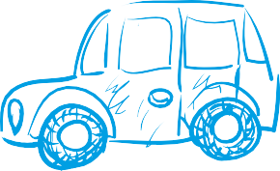




Types of Insurance
SECTION 2:6 | MAKING FINANCIAL DECISIONS
TASK TWO - ACTIVITY SHEET
EDUCATOR NOTES
Cut out the cards and match up the “Types of insurance” with the correct explanations.
Contents insurance | Life insurance
Pet insurance | Health insurance
Fully comprehensive car insurance | Travel insurance
Third party car insurance | Income insurance
Buildings insurance | Phone insurance
Spending Sense | Understanding insurance
Section 2:6 | Making Financial Decisions

Slide 22
Types of Insurance
SECTION 2:6 | MAKING FINANCIAL DECISIONS
TASK TWO - ACTIVITY SHEET
EDUCATOR NOTES
Cut out the cards and match up the “Types of insurance” with the correct explanations.
Cover vet bills if your pet needs an operation or medical treatment
Covers repairs to the structure of your home in case of damage, e.g. from a storm
Will pay money on your death.
Taken out when you have a mortgage
(loan for property)
Covers your possessions in the home against loss or damage
Covers loss of luggage, travel cancellations and medical expenses if you fall ill on holiday
Covers the cost of damage to yourself and your own
vehicle as well as damage you may cause to someone else or their property
Covers your income if you are unable to work due to illness/loss of job
Covers medical expenses and private treatment
Covers loss or damage to your phone
Covers the damage you do to someone else or their vehicle only
Spending Sense | Understanding insurance
Section 2:6 | Making Financial Decisions

Slide 23
Case Studies
SECTION 2:6 | MAKING FINANCIAL DECISIONS
TASK THREE - ACTIVITY SHEET
EDUCATOR NOTES
Amira
Amira has just bought a new phone. It’s top spec and brand new! Amira wants to protect herself in case she loses or damages the phone.
The shop offers her phone insurance costing £15 per month to cover her 2-year contract.
Or, Amira could save £15 per month ‘just in case’ she loses or damages the phone, she could then use that money towards a repair or replacement.
If in 2-years’ time she hasn’t needed to use the money she has saved, then she would have £360 to spend on a new phone.
Or, Amira could add the phone to her existing house insurance for an extra £5 per month.
What risks does Amira face?
What would you advise Amira to do and why?
What might happen if Amira doesn’t take any insurance?
Spending Sense | Understanding insurance
Section 2:6 | Making Financial Decisions

Slide 24
Case Studies
SECTION 2:6 | MAKING FINANCIAL DECISIONS
TASK THREE - ACTIVITY SHEET
EDUCATOR NOTES
James
James books a holiday to Spain. He can’t decide if he should take out insurance.
The holiday company want £65 to cover him for his holiday.
Or, James could look for annual travel insurance which would cost him about £85, but then he’d be covered for any other holidays he might take this year.
Or, James could just use his savings to cover his loss if the worst happens.
What are the risks James might face?
What would you advise James to do and why?
Would it make a difference if he didn’t have any savings?
Spending Sense | Understanding insurance
Section 2:6 | Making Financial Decisions

Slide 25
Case Studies
SECTION 2:6 | MAKING FINANCIAL DECISIONS
TASK THREE - ACTIVITY SHEET
EDUCATOR NOTES
Noor
Noor has had pet insurance for his dog since he got her, she’s now 9 years old.
Noor has never had to use the insurance so now he’s considering cancelling it.
Noor hasn’t looked at any other policies.
What risks does Noor face?
What would you advise Noor to do and why?
Even though Noor has never had to use the insurance in 9 years, what might Noor need to think about now in relation to his dog?
Spending Sense | Understanding insurance
Section 2:6 | Making Financial Decisions

Slide 26
Jargon Buster
SECTION 2:6 | MAKING FINANCIAL DECISIONS
TASK THREE - ACTIVITY SHEET
EDUCATOR NOTES
Claim Form | A form you fill out to get money back from the insurance company
Cover | The things you are protected against
Excess | You have to pay some money as well
Exclusions | Things that your insurance will not cover
No claims discount | You pay less if you did not claim for a year
Policy | Who and what is covered by your insurance
Premium | What you could pay each year for your insurance
Schedule | What is covered and not covered
Spending Sense | Understanding insurance
Section 2:6 | Making Financial Decisions

Slide 27

Insurance Outlines
SECTION 2:6 | MAKING FINANCIAL DECISIONS
TASK FOUR - ACTIVITY SHEET
EDUCATOR NOTES
Pick one type of insurance and then using the “Insurance outlines” write points about why that type of insurance would be good and help protect against risk.
Spending Sense | Understanding insurance
Section 2:6 | Making Financial Decisions

Slide 28
Insurance Outlines
SECTION 2:6 | MAKING FINANCIAL DECISIONS
TASK FOUR - ACTIVITY SHEET
EDUCATOR NOTES
Pick one type of insurance and then using the “Insurance outlines” write points about why that type of insurance would be good and help protect against risk.
Spending Sense | Understanding insurance
Section 2:6 | Making Financial Decisions

Slide 29
Comic Strip
SECTION 2:7 | MAKING FINANCIAL DECISIONS
TASK TWO - ACTIVITY SHEET
EDUCATOR NOTES
Create a comic strip on 'how to open a bank account' below
Spending Sense | Opening a bank account
Section 2:7 | Making Financial Decisions
116

