Slide 1
SECTION 3
Safety First
Spending Sense
119

Slide 2
Spending Sense Editable PowerPoint Guide ​
Who are these PowerPoints for?​
These editable PowerPoints are designed for both teachers and students. ​
Teachers can easily adapt the slides to fit their students’ needs, while students can work directly on the activities by adding text, matching images to words, and more. ​
Please go to the next slide to jump to the activity required.
How can I use them?
There are many ways to use these PowerPoints! You can:​
Edit and print them​
Project them on screen ​
Let students work on them directly from a computer​
Note: before editing them, we'd suggest saving another copy!​
How do I edit them?​
Every element on the activity pages is fully editable. You can: ​
Change images or text (content, font, size, colour)​
Add new text​
Customise the background colour​
Try editing an example for yourself here:​
IN-APP PURCHASE
£2.99
How do I access the audio? ​
Tasks with longer text in this resource comes with accompanying audio. Simply click the audio button to listen.
Income
Mo is 18 and goes to college.
He earns £7 an hour for working in a sports shop at the weekend.
He works eight hours a week and earns £240 a month.

Slide 3
SECTION 3
Safety First
Click below to jump to:
SECTION 3
3.1 Online Shopping
3.2 Is it Ok?
3.3 Protecting yourself online
3.4 Online Scams
3.5 Buyer beware: in-app purchases

Slide 4
Online Shopping Record Sheet
SECTION 3:1 | SAFETY FIRST
TASK TWO - ACTIVITY SHEET
EDUCATOR NOTES
Name:
Product:
Brand/Model:
 | Online retailer | Online auction site
Retailer/Auction site name
Price (£)
Special offers or discounts
Postage and packaging cost (£)
Total price (£)
Payment methods accepted
Contact details of seller (name, address, telephone number, email, website address)
Which seller will you choose?
Give reasons for you answer in the space below:
Spending Sense | Online Shopping
Section 3:1 | Safety First

Slide 5
Problem Cards
SECTION 3:1 | SAFETY FIRST
TASK THREE - ACTIVITY SHEET
EDUCATOR NOTES
1 | 2 | 3
The product brought on eBay has not come after 4 weeks. | The product arrives but is not as it looked on the site. | You buy the product but the website crashes after you have paid for it.
4 | 5 | 6
You open the package but the product is broken. | The product is not as described in the advert. | You want to return the product but there is no address.
7 | 8 | 9
The site is not secure. | Your credit card details are stolen. | The product you brought turns out to be faulty.
Spending Sense | Online Shopping
Section 3:1 | Safety First

Slide 6
Dilemmas
SECTION 3:2 | SAFETY FIRST
TASK TWO - ACTIVITY SHEET
EDUCATOR NOTES
Anita’s Story Since Anita is 18, she is allowed to buy alcohol. Her younger sister asks her to buy some alcoholic drinks to sell on to her friends who are 15. Anita would sell them for more than she bought them so she could keep the money she makes. | Shaun’s Story Shaun has just got an e-mail about an amazing job opportunity that will earn him £100 and it will only take him 10 minutes. The e-mail says that he just has to receive some money into bank account and then transfer it to a different account.
Alana’s Story Alana’s next-door neighbour has just offered her a summer job; he says it will last the full 6 weeks. He also said every Sunday he would give Alana £120 cash. She is not sure whether she should accept it or not. | Marvin’s Story Marvin’s friend’s nan has offered him and his friend a job at her market stall selling ‘luxury’ clothes. But Marvin knows they are fake. The market is on a Wednesday as well when Marvin and his friend should be in school.
Camila’s Story Camila’s neighbour has offered her a job at his building company repainting window frames. She would be on a ladder and is going to be paid £16 every time she paints a house. | Antonio’s Story While in town with his friends, a man comes up to Antonio and tells him that he can get £100 if he hands out some leaflets. Antonio reads the leaflet and it looks really dodgy, it says “if you provide us with your bank details, we will enter you in prize draw to win a holiday of a lifetime!”
Spending Sense | Is it OK?
Section 3:2 | Safety First

Slide 7
Reasons
SECTION 3:2 | SAFETY FIRST
TASK TWO - ACTIVITY SHEET
EDUCATOR NOTES
E This job offer is illegal because by accepting this offer he would become a money mule. A money mule is someone who transfers money illegally into another bank account and this is illegal. | A This job offer may be illegal if she is receiving cash and is not paying tax and National Insurance. It also may mean that the business is not insured for her to work at heights. If she has an accident she may not be insured.
C This job offer is most probably illegal because he could potentially be helping people scam innocent people out of all their money. Also working for cash without paying tax is illegal too. | B This job offer is illegal because you cannot sell alcohol to people under the age of 18. Also she could be contributing to binge drinking and addiction. Business owners must have a license to sell alcohol too.
D This job offer may be illegal because paying someone for a job in cash means that they could be trying to avoid certain legal requirements like paying tax. | F This job offer is illegal because he is under school leaving age and he should be in school. Also, selling fake goods is a breach of registered trademarks and they may be confiscated by the local Trading Standards office.
Spending Sense | Is it OK?
Section 3:2 | Safety First

Slide 8
Your Go!
SECTION 3:2 | SAFETY FIRST
TASK THREE - ACTIVITY SHEET
EDUCATOR NOTES
Jasmine’s Story
Jasmine’s uncle offered her a job working at his shop. She would be working at the weekend. In her job she would be selling food, alcohol and tobacco.
Her uncle will pay her £50 every weekend for her work at the shop.
Jasmine is 17 and is studying for her A-Levels and fears the job may get in the way of her studying.
Why may this be illegal? Add your ideas below.
Spending Sense | Is it OK?
Section 3:2 | Safety First
132

Slide 9
Consider your own Dilemma
SECTION 3:2 | SAFETY FIRST
TASK THREE - ACTIVITY SHEET
EDUCATOR NOTES
The dilemma
The reasons why it’s illegal
Spending Sense | Is it OK?
Section 3:2 | Safety First
133

Slide 10
SECTION 3:3 | SAFETY FIRST
TASK TWO - ACTIVITY SHEET
EDUCATOR NOTES
Top 10 tips to protect yourself online
1
Never disclose your security details to others
2
Use strong passwords/PINs
3
Do not use the same password/PIN for more than one account
4
Never write your passwords down
5
Only save passwords on private devices
6
Keep firewalls and anti-virus software up to date on all devices
7
Limit the amount of personal information you provide on social media
Make sure you have strong security settings on social media
8
9
Only accept online friend requests from people you know
10
Don’t do online banking on public Wi-Fi
137
Spending Sense | Protecting yourself online
Section 3:3 | Safety First 137

Slide 11
Discussion Questions
SECTION 3:3 | SAFETY FIRST
TASK TWO - ACTIVITY SHEET
EDUCATOR NOTES
1
Which do you think are the 3 most important ways to protect your identity? Compare your answers to your friend/person next to you
2
If you had to choose one to do today, which one would it be?
3
Create your own strong password – it should be something that you can remember but that a friend or family member wouldn’t be able to guess, it should contain both upper case and lower case letters, numbers and symbols, and be at least 8 characters.
Spending Sense | Protecting yourself online
Section 3:3 | Safety First

Slide 12
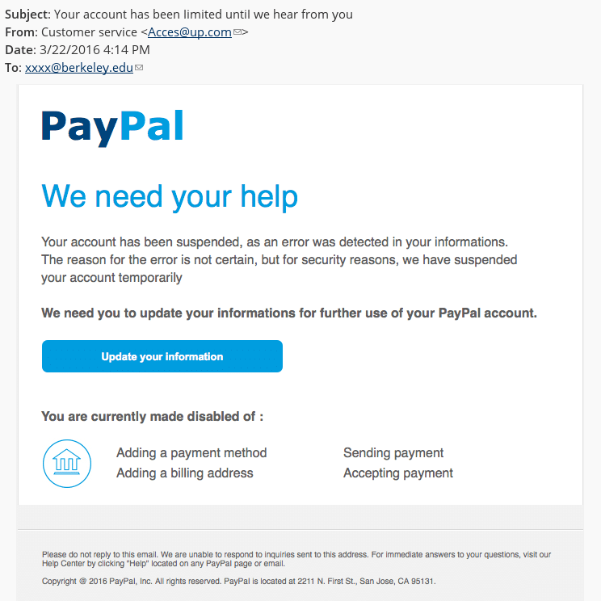
Spot the scams
SECTION 3:4 | SAFETY FIRST
TASK TWO - ACTIVITY SHEET
EDUCATOR NOTES
This email is in your inbox...
Why might you think this is not genuine?
Spending Sense | Protecting yourself online
Section 3:4 | Safety First
142

Slide 13
Spot the scams
SECTION 3:4 | SAFETY FIRST
TASK TWO - ACTIVITY SHEET
EDUCATOR NOTES
POINT
What do you think the scammers are trying to do?
What should you do now?
142
Spending Sense | Protecting yourself online
Section 3:4 | Safety First
143

Slide 14
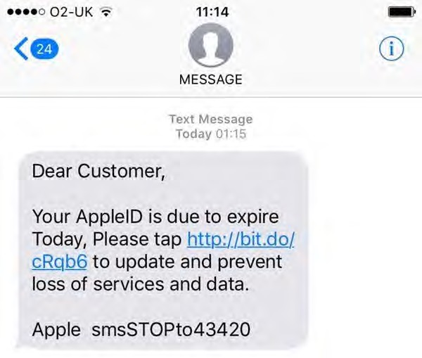
Spot the scams
SECTION 3:4 | SAFETY FIRST
TASK TWO - ACTIVITY SHEET
EDUCATOR NOTES
You receive this text message...
Why might you think this is not genuine?
143
142
Spending Sense | Protecting yourself online
Section 3:4 | Safety First
144

Slide 15
Spot the scams
SECTION 3:4 | SAFETY FIRST
TASK TWO - ACTIVITY SHEET
EDUCATOR NOTES
What do you think the scammers are trying to do?
What should you do now?
143
142
Spending Sense | Protecting yourself online
Section 3:4 | Safety First
145

Slide 16
SECTION 3:4 | SAFETY FIRST
TASK THREE - ACTIVITY SHEET
EDUCATOR NOTES
Top 5 tips to prevent becoming a victim of scams
Spending Sense | Online scams
Section 3:4 | Safety First
147

Slide 17
Danielle’s Story
SECTION 3:5 | SAFETY FIRST
TASK ONE - ACTIVITY SHEET
EDUCATOR NOTES
Put the story in order...
Next time she logged into the game she was offered a 1 week free trial for a VIP pack which would give her unlimited gems for £6.99 per week.
Danielle panicked when she saw her bank statement and deleted the app, thinking
this would stop the weekly payments.
However, the app kept trying to take money from her account and she no longer had the money to pay.
She got a letter from the app company saying they will take legal action for money owed. Luckily, Danielle’s parents found this letter and were able to cancel the payments officially.
Danielle thought this was an amazing idea and so without reading the small print, she clicked on the deal.
She thought earning gems on the game took too long and wasted her time. Using her birthday money, she purchased
£3.99 worth of gems to get to the next level.
A week later Danielle forgot to cancel the VIP pack and £6.99 came out of her bank account. The next week a further £6.99 came out of her bank.
Danielle downloaded a free game from the app store and started playing it a lot.
Spending Sense | Buyer beware: in-app purchases
Section 3:5 | Safety First
151

Slide 18
Danielle’s Story
SECTION 3:5 | SAFETY FIRST
TASK ONE - ACTIVITY SHEET
EDUCATOR NOTES
Correct Order...
1
Danielle downloaded a free game from the app store and started playing it a lot.
2
She thought earning gems on the game took too long and wasted her time. Using her birthday money, she purchased £3.99 worth of gems to get to the next level.
3
Next time she logged into the game she was offered a 1 week free trial for a VIP pack which would give her unlimited gems for £6.99 per week.
4
Danielle thought this was an amazing idea and so without reading the small print, she clicked on the deal.
5
A week later Danielle forgot to cancel the free trial of the VIP pack and £6.99 came out of her bank account. The next week a further £6.99 came out of her bank.
6
Danielle panicked when she saw her bank statement and deleted the app, thinking this would stop the weekly payments.
7
However, the app kept trying to take money from her account and she no longer had the money to pay for it.
8
She got a letter from the app company saying they will take legal action for money owed. Luckily, Danielle’s parents found this letter and were able to cancel the payments officially.
Spending Sense | Buyer beware: in-app purchases
Section 3:5 | Safety First

Slide 19
Problem Page Letters
SECTION 3:5 | SAFETY FIRST
TASK TWO - ACTIVITY SHEET
EDUCATOR NOTES
Dear Alex,
I’m really worried about ^{my friend}
Charlie; he is spendin^{g lots of money}
buying extra players in a gam^{e he is}
playing. He has spent ^{all the money in}
his bank account an^{d has tried to borrow}
money from me to buy more.
What should I do?
Spending Sense | Buyer beware: in-app purchases
Section 3:5 | Safety First

Slide 20
Problem Page Letters
SECTION 3:5 | SAFETY FIRST
TASK TWO - ACTIVITY SHEET
EDUCATOR NOTES
Dear Alex,
^{I’m 15} years old and have been
buying lots of games to play on _{my}
^{phon}e. One of them is costing me
£2.99 each month. I don’t even lik_{e}
playing it anymore.
What should I do?
Spending Sense | Buyer beware: in-app purchases
Section 3:5 | Safety First

Slide 21
Problem Page Letters
SECTION 3:5 | SAFETY FIRST
TASK TWO - ACTIVITY SHEET
EDUCATOR NOTES
Dear Alex,
I used my mum’s card to make an
app purchase, I’ve been playing
a game and buying extra c^{oins I}
thought they were free but now
I realise that each ‘pur^{se of coins’}
costs £4.99 and its being taken out
of my mum’s account!
I think I’ve spent a lot of money. What shall I do?
Spending Sense | Buyer beware: in-app purchases
Section 3:5 | Safety First

