Slide 1

SECTION 4
The World
of Work
Spending Sense
157

Slide 2



Spending Sense
Editable PowerPoint Guide ​
Who are these PowerPoints for?​
These editable PowerPoints are designed for both teachers and students. ​
Teachers can easily adapt the slides to fit their students’ needs, while students can work directly on the activities by adding text, matching images to words, and more. ​
Please go to the next slide to jump to the activity required.
How can I use them?
There are many ways to use these PowerPoints! You can:​
Edit and print them​
Project them on screen ​
Let students work on them directly from a computer​
Note: before editing them, we'd suggest saving another copy!​
How do I edit them?​
Every element on the activity pages is fully editable. You can: ​
Change images or text (content, font, size, colour)​
Add new text​
Customise the background colour​
Try editing an example for yourself here:​
IN-APP PURCHASE
£2.99
How do I access the audio? ​
Tasks with longer text in this resource comes with accompanying audio.
Simply click the audio button to listen.
Income
Mo is 18 and goes to college.
He earns £7 an hour for working in a sports shop at the weekend.
He works eight hours a week and earns £240 a month.

Slide 3

SECTION 4
The World
Of Work
Click below to jump to:
SECTION 4
4.1 Job Titles
4.2 Understanding your payslip
4.3 Earning Money

Slide 4







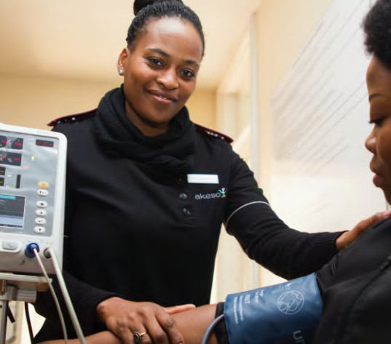

Job Titles
SECTION 4:1 | THE WORLD OF WORK
TASK ONE - ACTIVITY SHEET
EDUCATOR NOTES
Spending Sense | The world of work
Section 4:1 | The World of Work
160

Slide 5
Job Role Research Template
SECTION 4:1 | THE WORLD OF WORK
TASK TWO - ACTIVITY SHEET
EDUCATOR NOTES
Think of one or more jobs you would like to do when you leave school or college and conduct some online research to help you plan your career path.
Job Title | Tasks | Skills needed | Qualifications needed | Starting salary
Spending Sense | The world of work
Section 4:1 | The World of Work
163

Slide 6
Payslips
SECTION 4:2 | THE WORLD OF WORK
TASK THREE - ACTIVITY SHEET
EDUCATOR NOTES
Payslip for Mei
Company name:
Employee name:
Payment method - BACS
Payment period - MONTHLY
ANNUAL GROSS SALARY
PAYMENTS
DEDUCTIONS
Basic salary
Income tax deduction
National Insurance
Payslip no 01
Date
Department
Net pay this month
Spending Sense | Understanding your payslip
Section 4:2 | The World of Work

Slide 7
Payslips
SECTION 4:2 | THE WORLD OF WORK
TASK THREE - ACTIVITY SHEET
EDUCATOR NOTES
Payslip for Joel
Company name:
Employee name:
Payment method - BACS
Payment period - MONTHLY
ANNUAL GROSS SALARY
PAYMENTS
DEDUCTIONS
Basic salary
Income tax deduction
National Insurance
Payslip no 01
Date
Department
Net pay this month
Spending Sense | Understanding your payslip
Section 4:2 | The World of Work

Slide 8
What have you learned?
SECTION 4:2 | THE WORLD OF WORK
TASK THREE - ACTIVITY SHEET
EDUCATOR NOTES
Match up the keywords with the definitions
Income tax
Pay before deductions
Gross pay
An amount of money earned usually expressed as a weekly amount
or hourly rate
Deductions
Bring home pay, after deductions
National Insurance
An amount of money earned usually expressed as an annual sum
Net pay
A tax paid on earnings and collected by the Government to fund public services
Salary
A tax which pays towards your state pension, sick pay and other benefits
Wage
Payments taken by the government and employer to pay for public services and also pensions
Spending Sense | Understanding your payslip
Section 4:2 | The World of Work

Slide 9
True or False
SECTION 4:3 | THE WORLD OF WORK
TASK TWO - ACTIVITY SHEET
EDUCATOR NOTES
The youngest a child can work a part time job is 13, unless they have a
permit to work in: modelling, television or theatre
TRUE OR FALSE
A child is not allowed to work before 7am and after 7pm
TRUE OR FALSE
A child is allowed to work in pubs and betting shops
TRUE OR FALSE
Children are not allowed to work in factories
TRUE OR FALSE
Children can work for 10 hours without breaks
TRUE OR FALSE
Children are allowed to work in places that can be potentially dangerous and harmful to their health
TRUE OR FALSE
They cannot work for 4 hours without having one break
TRUE OR FALSE
Spending Sense | Earning money
Section 4:3 | The world of work
177

Slide 10
Legal or Not?
SECTION 4:3 | THE WORLD OF WORK
TASK THREE - ACTIVITY SHEET
EDUCATOR NOTES
Are these jobs legal for someone under 16 or not? Move the below into two piles: legal or not?
Legal
Not
Waitressing Job
Working in a bar/restaurant from 5pm to 10pm on a Friday
and Saturday night.
Local Shop Job
Saturday job – 5 hour shift from 10am to 3pm.
Cleaning Job
Cleaner for a betting shop 3pm to 6pm Saturday and Sunday.
Paper Round
Monday to Friday newspaper delivery round. Start at 5am.
Factory Packer
Saturday and Sunday 10am to 4pm.
Hairdressers Help
Friday evening 4.30pm to 7.00pm and Saturdays 9am to 4pm.
Spending Sense | Earning money
Section 4:3 | The world of work

Slide 11
Case Studies
SECTION 4:3 | THE WORLD OF WORK
TASK THREE - ACTIVITY SHEET
EDUCATOR NOTES
Lauren’s Story
My next-door neighbour has just offered me a job as a waitress at his bar. I am only 14.
He says my day would start at 5pm and would end at 10pm. I would not have any breaks either.
Should I accept?
Would it still be ok if Lauren was 17?
Why, why not?
Spending Sense | Earning money
Section 4:3 | The world of work

Slide 12
Case Studies
SECTION 4:3 | THE WORLD OF WORK
TASK THREE - ACTIVITY SHEET
EDUCATOR NOTES
Karter’s Story
Every weekday I do a paper round starting at 5am before school. I am 15. I am very tired for the rest of the day and think I should quit.
Should I?
What would you change to make the job legal?
Spending Sense | Earning money
Section 4:3 | The world of work

Slide 13
Case Studies
SECTION 4:3 | THE WORLD OF WORK
TASK THREE - ACTIVITY SHEET
EDUCATOR NOTES
Stevie’s Story
My aunty has just offered me a job at her betting shop cleaning up after all the customers. I am only 16.
The plan is to start around 7pm and finish around 10pm.
Should I accept?
Would it still be ok if I cleaned at 5am?
Why, why not?
Spending Sense | Earning money
Section 4:3 | The world of work

